Slide 1

Tiered Fidelity Inventory (TFI) 3.0:
Preparing and Scoring Tier 3 Items
Version 3.0
March 2025
Access the audio on the slides by clicking on the audio icon.
Notes:
Audio:
Welcome to the Tiered Fidelity Inventory 3.0 resource presentation. The purpose of this slide deck is to review the format of the fidelity tool, provide clear steps for administration, and provide scoring guidance for school teams.
As you did on this first slide, look for the audio icon on each slide to access the accompanying audio.

Slide 2

Purpose of this Resource:
Intended use: to prepare coaches and facilitators who will be guiding administration and use of the TFI with school teams.
Resource Components:
  Overview of the Tier 3 Administration Process
  Preparation for Tier 3 Administration
  Tier 3 Item Presentation
Links to resources outside of this presentation:
Tiered Fidelity Inventory 3.0 Tier 1 Administration
Tiered Fidelity Inventory 3.0 Tier 2 Administration
Notes:
Audio:
This resource has been created specifically for coaches and facilitators who will assist school teams as they complete the TFI 3.0.
In this presentation, we will provide an overview of the tier 3 administration process, directions for preparing to administer (including suggestions for readiness), and an item-by-item presentation with scoring guidance.
We anticipate that our audience may come to the 3.0 with varying levels of previous experience with fidelity measures and PBIS implementation. And, we expect that you may need to reference this resource multiple times, so links are available to help you navigate to the topics of most interest. A separate resource is available to support teams to administer the Tier 1 and 2 sections of the TFI.

Slide 3
Overview of the TFI
The Tiered Fidelity Inventory 3.0 is a measure of the extent to which school teams are applying core features of school-wide PBIS (SWPBIS).
The TFI 3.0 has three subscales:
  Tier I: 20 Items
  Tier II: 15 Items
  Tier III: 19 Items
Notes:
Audio:
The purpose of the PBIS Tiered Fidelity Inventory (TFI) 3.0 is to provide a valid, reliable, and efficient measure of the extent to which school personnel are applying the core features of school-wide positive behavioral interventions and supports (SWPBIS). The TFI is divided into three sections (Tier 1: Universal PBIS Features; Tier 2: Targeted PBIS Features; and Tier 3: Individualized PBIS Features). The TFI is intended to guide both initial implementation and sustained use of PBIS.
While each Tier of items can be used separately or in combination to assess the extent to which core features are in place, it is recommended that teams who intend to complete the Tier 3 items also complete the Tier 1 and 2 sections to engage in a more well-rounded self-assessment.

Slide 4
TFI Tier 3 Administration Process
Completed by a school’s Leadership Team or Systems Planning Team
Completion with an External Coach recommended
More frequent administration for early implementors
Paper/pencil or PBISApps.org
There is no cost to complete the TFI
Notes:
Audio:
The TFI is completed by a school’s leadership Team or Systems Planning Team (typically 3-8 individuals including a building administrator and external coach or district coordinator), often with input from Tier 1, 2, and/or 3 teams if these are independent groups. For each score, teams will need to come to a consensus. It is strongly recommended that the TFI be completed with an external PBIS coach as a facilitator. Validity research on the TFI 3.0 shows that school teams are more accurate when an external coach facilitates TFI completion.
School teams are encouraged to self-assess PBIS implementation when they initially launch implementation of PBIS and then every third or fourth meeting until they reach fidelity across three consecutive administrations. Once fidelity on a tier is met, the team may choose to shift to annual TFI assessment to evaluate sustained implementation. Note that schools new to PBIS may start by using only the Tier 1 section of the TFI, and as they improve their implementation of Tier 1, they may add assessment of Tier 2 and/or Tier 3 features.
The TFI may be completed using paper and pencil or by accessing the surveys on www.pbisapps.org. Any school working with a state PBIS coordinator, trainer or coach may access the website, TFI content, and reports. The TFI may also be downloaded from www.pbis.org. There is no cost to use the TFI or its online scoring and reporting features.

Slide 5

PBIS Assessment
PBIS Assessment is a free application available to help record your TFI 3.0 data online!
Click here for more information on PBIS Assessment

Slide 6
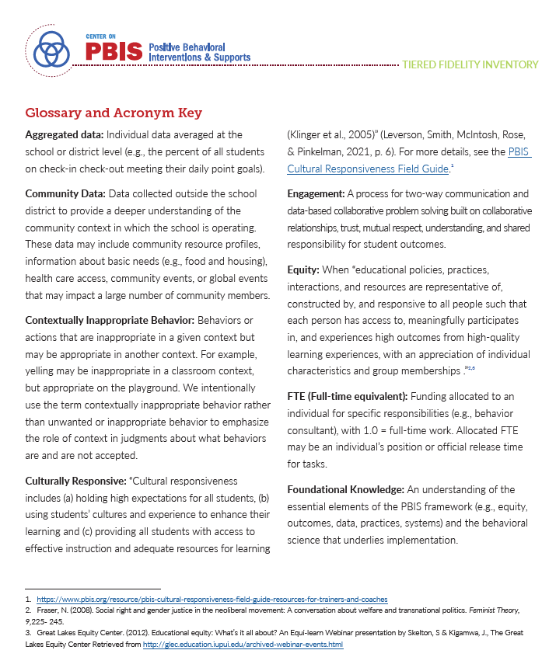
Glossary and Acronym Key
Notes:
Audio:
There may be terminology or acronyms used throughout the TFI that is unfamiliar to your team. You can reference the Glossary and Acronym Key in the manual for clarification.

Slide 7
Tier 3: Individualized Interventions
Click on each item you want to focus on, or go through the full set of slides:
Subscale: Teams | Subscale: Leadership Team Practices | Subscale: Systems | Subscale: Data | Subscale: Individualized Support
3.1 Team Composition 3.2 Team Operating Procedures | 3.3 Screening 3.4 Comprehensive Assessment Protocol 3.5 Individual Support Plan Protocol 3.6 Access to Tier 1 and Tier 2 Supports | 3.7 Leadership Team Professional Development and Coaching 3.8 Level of Use 3.9 Staffing 3.10 Student Engagement 3.11 Family and Community Engagement 3.12 Faculty ad Staff Engagement | 3.13 Decision Making with Aggregated Student Performance Data and Fidelity Data 3.14 Evaluation Plan | 3.15 Individual Support 3.16 Individual Assessment Plans 3.17 Individual Support Plans 3.18 Individual Support Plan Orientation and Training 3.19 Individualized Data-based Decision Making
Notes:
Audio
Tier 3 supports refer to the practices and systems that enable individualized interventions for students who are not successful with Tier 1 and Tier 2 supports. The focus at Tier 3 is supporting students using a tailored, individualized approach that relies on a comprehensive collection of data and results in a student-centered support plan.
Similar to the Tier 1 and Tier 2 sections, this part of the TFI is comprised of items related to Teams, Practices, Systems, and Data. An additional subscale contains four items directly related to the delivery of individualized support. The subscale scores are based on the scores of the items within the subscale. This format helps team engage in more precise progress monitoring and action planning.
You can view each item in order, or you can click on the particular items about which you’d like more information.

Slide 8
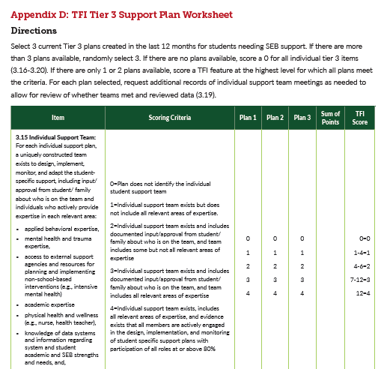
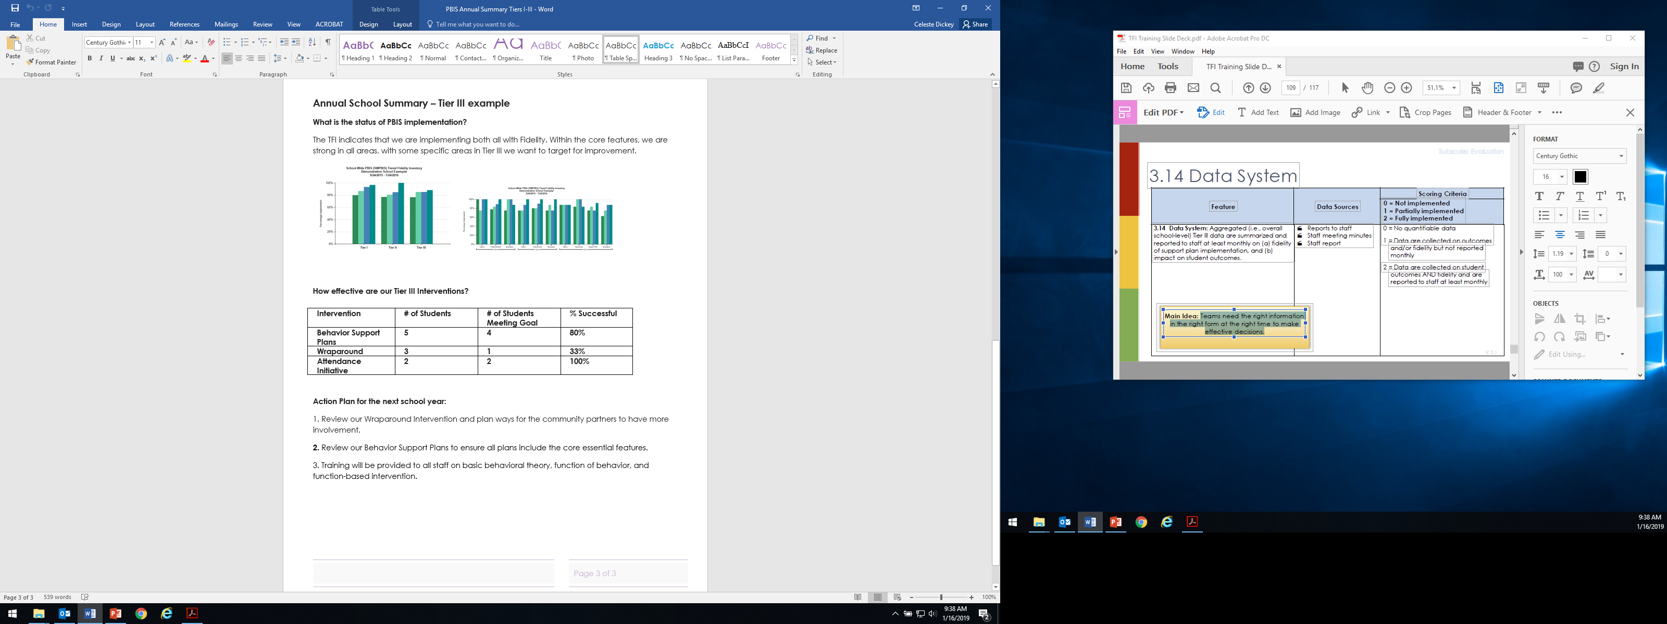
Preparation for Administration
Assemble relevant personnel
Access/review decision rules for screening for Tier III needs (if in place)
Access/review the Assessment Protocol used to gather data (if in place)
Access/review the Support Plan Protocol used to guide development of individualized support plans (if in place)
Increase familiarity with the TFI Tier 3 Support Plan Worksheet (Appendix D)
Gather 3 randomly selected Tier III Student Support Plans (created in the last 12 months)
Access the existing Annual Evaluation Plan (if in place)
Notes:
Audio:
Here are some recommendations for how teams can prepare to complete the Tier III section of the TFI. Having access to any existing protocols and the existing evaluation plan will make the process more efficient.
To score items in the Individualized Support subscale (items 3.15 though 3.19) teams will use the TFI Tier 3 Support Plan Worksheet, located in Appendix D of the TFI manual.

Slide 9
TFI Feature Number and Name
Subscale: Name
Feature Description
Possible Data Sources
Main idea:
An explanation of the main idea for this feature
Notes:
Audio:
As teams sit down to complete the TFI, they will read through each item and rate themselves based on identified scoring criteria. Throughout this presentation, each item of the TFI is described in this format: At the top of the slide is the item name and number. The subscale that the item is associated with is in the top row of the chart. Below that is the item description and the possible data sources that can assist in scoring. Included is also a main idea statement that summarizes the main purpose of the item and how it relates to the bigger picture of PBIS implementation.

Slide 10
TFI Feature Number and Name
0 | 1 | 2 | 3 | 4
Scoring criteria for a score of 0. | Scoring criteria for a score of 1. | Scoring criteria for a score of 2. | Scoring criteria for a score of 3. | Scoring Criteria for a score of 4.
Reflective questions to focus the conversation: Question Documentation Process
Notes:
Audio:
For each item, there will also be a scoring slide to assist the team in scoring the item. Each of these slides also include reflection questions to help guide your team with building consensus around a score. This most recent version of the TFI has an expanded, 5-point scale rather than the previous version’s 2-point scale.

Slide 11
3.1 Team Composition
Subscale: Leadership Team
Tier 3 leadership team (or combined Tier 2 and Tier 3 Team) includes the following roles: 1-2 Tier 3 systems coordinators (e.g., coaches), a school administrator, a representative group of educators (e.g., grade level or departmental representation, general and special education, certified and non-certified staff), members from marginalized groups, relevant community partners (e.g., mental health providers), and individuals who actively provide expertise in the following areas: applied behavior support mental health and trauma academic instruction coaching equity physical health and wellness (e.g., nurse, health teacher) data systems and information regarding system and student academic and SEB strengths and needs operations of the school across grade levels and programs
Possible Data Sources | School organizational chart Tier 3 team meeting minutes District capacity assessment
Main idea:
Tier 3 leadership teams need individuals with specific skills and perspectives to effectively provide and implement Tier 3 supports.
Back to ALL ITEMS
Notes:
Audio:
Similar to teams at the other tiers, the Tier 3 team requires individuals with specific knowledge, expertise, and perspective. Notice the emphasis on members from marginalized groups and relevant community partners, which may include mental health providers. How the team is formed may be specific to the local context- for example, a smaller school may combine their Tier 2 and 3 teams however it is important to be sure that all roles are filled.

Slide 12
3.1 Team Composition
0 | 1 | 2 |  | 3 | 4
Team does not exist or does not include a coordinator, school administrator, or individuals with applied behavioral expertise. | Team exists, but does not include all identified roles, or participation of these members is below 80%. | Team with all roles exists and is actively engaged with participation of all roles at or above 80%. |  | Team with all roles exists, is actively engaged with participation of all roles at or above 80%, and either a written process exists for selecting, orienting, recruiting, and retaining team members or Tier 3 leadership team includes members from the group that is most exposed to disparate outcomes in your school (e.g., exclusionary discipline, bullying, mental health referrals) | Team with all roles exists, is actively engaged with participation of all roles at or above 80%, and both a written process exists for selecting, orienting, recruiting, and retaining team members and Tier 3 leadership team includes members from the group that is most exposed to disparate outcomes in your school
Team roles assessment: Are all necessary roles/functions represented on the team? Systems coordinator School administrator Representative educators Members from marginalized groups Community partners |  |  | Expertise in: applied behavior support mental health and trauma academic instruction coaching equity physical health & wellness data systems & information school operations
Back to ALL ITEMS
Notes:
Audio
Scoring for this item is based on the representation of roles, consistent participation in meetings, and processes for recruiting, orienting, and retaining team members. The team should include the roles in the checklist. One person may provide more than one role/perspective. For example, someone with behavioral expertise may also provide coaching.
The Tier III team does not need to be large and in some instances, may be combined with the Tier II team. The key is to ensure that the authority to make decisions exists, and the behavioral expertise is present to guide adaptations.

Slide 13
3.2 Team Operating Procedures
Subscale: Leadership Team
Tier 3 leadership team has (a) regular meeting format/agenda that prompts the regular review of Tier 3 practices, systems, and data, (b) established and regularly used team norms, (c) defined meeting roles (e.g., timekeeper, facilitator, recorder), (d) regular (e.g., quarterly) two-way data sharing and communication with Tier 1 and Tier 2 teams to inform decision making, (e) a current action plan, (f) procedure for evaluating fidelity of team operating procedures (e.g., Team Initiated Problem Solving [TIPS] Fidelity Checklist) at least twice annually, (g) a formal process to monitor the impact of team norms, and (h) procedures on ensuring all team members are able to participate as equal partners.
Possible Data Sources | Tier 3 team meeting agendas and minutes Tier 3 meeting roles descriptions Tier 3 action plan Team Initiated Problem Solving (TIPS) fidelity checklist items 1-9
Main idea:
Tier 3 teams need meeting foundations in order operate efficiently and to implement effective supports.
Back to ALL ITEMS
Notes:
Audio:
This Item focuses on the team operating procedures that will assist the team to run efficient and effective meetings. The main idea is that teams utilize operating procedures that will ensure teams effectively action plan and track progress during their meetings.

Slide 14
3.2 Team Operating Procedures
0 | 1 | 2 | 3 | 4
Team does not meet monthly, use regular meeting format/agenda, minutes, defined roles, or a current action plan. | Team meets at least monthly and has at least three but not all six of the procedures listed a-f. | Team meets at least monthly and has at least four but not all six of the procedures listed a-f. | Team meets at least monthly and has at least five but not all six of the procedures listed a-f, and either g or h. | Team meets at least monthly and has all eight of the procedures listed a-h.
Reflective questions to focus the conversation: Does the team have regular monthly meetings, norms, and roles? Is there regular data sharing with the Tier 1 and 2 teams? Is there a current action plan? Does a procedure exist to review fidelity of team operating procedures and norms? Are there procedures to ensure equal participation of team members?
Back to ALL ITEMS
Notes:
Audio
Scoring for this item is based on the number of procedures that are in place. Use the checklist to help determine what is currently in place and specific ways to strengthen team operations.
For schools whose Tier 2 and 3 teams are combined, considerations are needed to ensure effectiveness during meetings, including a designated time to focus specifically on Tier 3 items.

Slide 15
3.3 Screening
Subscale: Leadership Team Practices
Tier 3 leadership team uses decision rules and multiple sources of data (e.g., discipline referrals, Tier 2 performance, request for assistance process, academic progress, screening tools, attendance, nominations, crisis/safety plan development) to identify students with internalizing or externalizing needs who require Tier 3 supports. Data are available from multiple informants (e.g., teacher, family, student) and at multiple points in time (e.g., screening at identified points, ongoing data review, ongoing access to request for assistance process).
Possible Data Sources | Multiple data sources used (e.g., discipline referrals, time out of assigned instruction, attendance, academic performance) Team decision rubric Team meeting minutes School policy
Main idea:
Timely and accurate identification of students in need of Tier 3 supports improves the effectiveness of Tier 3 implementation.
Back to ALL ITEMS
Notes:
Audio:
The focus of this item is on the established process that supports the identification of students who require individualized supports. Notice the explicit emphasis on data from multiple informants and at multiple points in time. These characteristics support the accurate selection of students and contributes to the overall timeliness of the implementation process.

Slide 16
3.3 Screening
0 | 1 | 2 | 3 | 4
No specific rules for identifying students who qualify for Tier 3 supports. | Decision rules established but not consistently followed. | Decision rules established with teams using only 1 of the following: multiple data sources, multiple informant options, multiple points in time. | Decision rules established with teams using only 2 of the following: multiple data sources, multiple informant options, multiple points in time. | Decision rules established with teams using all of the following: multiple data sources, multiple informant options, multiple points in time.
Reflective questions to focus the conversation: Do you have a written policy or rubric for identifying students in need of assistance? Is this policy consistently followed? Do you use multiple data sources in identifying students for Tier 3 interventions? Are there options for multiple informants? Are data sources from multiple points in time?
Back to ALL ITEMS
Notes:
Audio:
Scoring for this item is based on the criteria met in the checklist. Full implementation requires that decision rules include multiple data points, multiple informants, AND multiple points in time.

Slide 17
3.4 Comprehensive Assessment Protocol
Subscale: Leadership Team Practices
Tier 3 leadership team (defined in item 3.1) develops, implements, and monitors the use of a comprehensive assessment (e.g., functional behavioral assessment [FBA]) protocol to guide consideration of all data gathered in the context of Tiers 1 and 2, information uncovered during screening (item 3.3), and other relevant data sources on strengths and needs across life domains including behavioral (e.g., attendance, functional behavioral assessment, suspension/expulsion), academic (e.g., reading, math, writing), medical, and mental health data. The protocol prompts the examination of the following student-specific elements: strengths: data-based statement of the student's SEB strengths that honors student and family values, student identity, and lived experiences needs: operational description of internalizing or externalizing SEB need (e.g., chronic or significant display of contextually inappropriate behavior) hypothesis statement: data-based identification of situations (antecedents) that predict and reinforcers that maintain these behaviors (i.e., statement of behavioral function) additional information: other relevant indicators of strength and need relevant to developing an individual support plan (e.g., diagnostic academic data, attendance, mental health/wellness, physical health/wellness, basic needs across life domains)
Possible Data Sources | Review of comprehensive assessment protocol
Main idea:
A thorough assessment protocol is needed to ensure consistency and technical adequacy across student assessments.
Back to ALL ITEMS
Notes:
Audio:
This item is focused on the development and use of an assessment protocol that directs the data collection efforts when developing individualized student supports. A protocol that is comprehensive will require data collection from multiple sources and prompts understanding of the student-specific elements outlined.

Slide 18
3.4 Comprehensive Assessment Protocol
0 | 1 | 2 | 3 | 4
No protocol for conducting a comprehensive assessment exists. | A protocol exists for conducting assessments in Tier 3, but the protocol does not include all data sources listed, or prompt all student specific elements. | A written protocol for conducting comprehensive assessment exists, includes all data sources listed and prompts all student-specific elements, but the leadership team does not actively monitor adherence to protocol elements. | A written protocol for conducting comprehensive assessment exists, includes all data sources listed, prompts all student-specific elements and it is used across most student support teams and the leadership team actively monitors adherence to protocol elements. | A written protocol for conducting comprehensive assessment exists, includes all data sources listed and prompts all student-specific elements, and it is implemented consistently across all student support teams, and the leadership team actively monitors adherence to protocol elements.
Reflective questions to focus the conversation: Is there a protocol in place that guides a comprehensive assessment? Does the protocol include all data sources and student-specific elements? Is there active monitoring to ensure that the protocol is followed? Is the protocol used across all student support teams?
Back to ALL ITEMS
Notes:
Audio:
To score this item, teams will review their assessment protocol, if one exists. If a protocol is not in place, teams will score a zero for this item.
Scoring for this item is based on the criteria in the checklist. Teams are encouraged to pay particular attention to the student-specific elements listed, including the creation of a hypothesis statement, which will be used to identify appropriate tier 3 supports for the student. The next slide provides support for writing strong hypothesis statements. It is important to note that this item refers only to the quality of the protocol or process itself, the application or use of the protocol with students will be assessed in TFI item 3.16.

Slide 19
Sample Hypothesis Statements:
Edith doesn’t line up on time when the bell rings and morning recess is over. She continues to play on the slide until the EA comes to get her. The hypothesized function of her behavior is to gain adult attention.
Rogelio repeatedly talks out in Math class and interrupts the teacher and students. He is sent to a buddy classroom to complete his work. The hypothesized function of the behavior is to avoid Math and gain peer attention.
Back to ALL ITEMS
Notes:
Audio:
A well-written hypothesis statement will clearly define the contextually inappropriate behavior (include the setting or context) and include a hypothesis about the function of the behavior. A hypothesis statement is written after all data has been reviewed and is based on patterns of behavior.
To hypothesize the function of a behavior, consider the antecedents (what was happening at the time that the behavior occurred), the adult response to the behavior, and what the students may be trying to obtain or avoid. This could include attention, a tangible item or activity, or a sensory condition. As can be seen in the second example, behaviors can serve more than one function.

Slide 20
3.5 Individual Support Plan Protocol
Subscale: Leadership Team Practices
Tier 3 leadership team develops, implements and monitors the use of an individual support plan protocol to guide the development of individualized support plans based on individualized assessment data (item 3.16), including decision rules for matching plan to student level of need (e.g., brief, comprehensive, wrap-around) and all of the following plan elements: prevention strategies teaching strategies consequence strategies: to encourage or reinforce contextually appropriate behaviors to prevent reinforcement of and respond to contextually inappropriate behaviors safety elements that prioritize alternatives to restraint where needed systematic process for assessing fidelity and impact action plan for putting the comprehensive support plan in place adaptations or modifications to Tier 1 and 2 supports are prioritized before adding new interventions
Possible Data Sources | Review of comprehensive individual support protocol
Main idea:
Tier 3 supports are more effective when matched to student need and include specific elements.
Back to ALL ITEMS
Notes:
Audio:
While the previous item focused on the process to gather different types of data, this item is centered around the protocol used to guide the development of student-specific individualized support plans. The item explicitly identifies characteristics of effective plans, including a process to assess fidelity and impact and the considerations of adaptations or modifications of Tier 2 supports before adding new interventions.
Examples of these plan elements can be found on the next slide.

Slide 21
Individual Support Plan Elements
Strategies: | Description/Examples
Prevention | Focus on prevention first: reducing the situations that lead to these behaviors? (e.g., change seat, morning check in, etc.)
Teaching | Ensure students know the correct behavior by teaching and re-teaching: (e.g., school-wide expectations, routine, social skills)
Specific rewards, that meet the function of behavior, to reinforce contextually appropriate behavior | Ensure that appropriate behavior is rewarded in a functionally relevant manner (e.g., provide attention for students reinforced by accessing attention, provide brief break for students reinforced by escaping or avoiding) and strive for 5:1 positives to corrections
To prevent reinforcement of (and respond appropriately to) contextually inappropriate behavior | Ensure that problem behavior isn’t rewarded: (e.g., student who wants to be sent out of class – provide consequence that doesn’t remove student from class). Use evidence-based response practices: increase proximity; deliver error corrections with an instructional tone; ignore- attend-praise; use self-monitoring strategies.
Safety elements (when needed) | If safety is a concern, develop a plan that includes prevention and a system for de-escalation and/or responding to the issue.
Systems:
Assess fidelity & impact | Ensure assessment for fidelity of implementation to the plan and the impact on student behavior
Action plan | Develop an action plan for putting the plan in place (What, Who, When)
Adaptations to Tier 1 and 2 supports prioritized | Ensure that school-wide and classroom practices are used with fidelity; consider adaptations to Tier 2 interventions that are more student-specific (e.g., CICO goals expanded to include specific behaviors that meet the school-wide expectations).
Back to ALL ITEMS
Notes:
Audio:
This chart provides definitions and some examples of the necessary elements within individual support plans.

Slide 22
3.5 Individual Support Plan Protocol
0 | 1 | 2 | 3 | 4
No protocol for developing and implementing individualized Tier 3 support exists. | A written protocol exists for developing and implementing individual support plans, but the protocol does not include decision rules for matching to student level of need or include all plan elements (1-7) | A written protocol exists for developing and implementing individual support plans, and the protocol includes decision rules for matching to student level of need and includes all plan elements (1-7) but the leadership team does not actively monitor adherence to protocol elements. | A written protocol exists for developing and implementing individual support plans, and the protocol includes decision rules for matching to student level of need and includes all plan elements (1-7) and it is implemented consistently across some student support teams and the leadership team actively monitors adherence to protocol elements. | A written protocol exists for developing and implementing individual support plans, and the protocol includes decision rules for matching to student level of need and includes all plan elements (1-7) and it is implemented consistently across all student support teams and the leadership team actively monitors adherence to protocol elements.
Reflective questions to focus the conversation: Is there a protocol/process for developing and implementing student-specific supports? Does the protocol include decision rules for matching to student level of need? Are all of the elements included in student support plans? Is there a process to monitor adherence to protocol elements (i.e., fidelity)? Is the protocol used across all student support teams?
Back to ALL ITEMS
Notes:
Audio:
To score this item, teams will review their individual support plan protocol, if one exists. If a protocol is not in place, teams will score a zero for this item.
Scoring is based on the degree to which characteristics of the checklist are in place. Notice that higher scores require a system to monitor adherence to the protocol. It is important to note that this item focuses on the development and quality of the protocol only. Consistent use of the protocol is assessed in a later TFI item (3.17).

Slide 23
3.6 Access to Tier 1 & Tier 2 Supports
Subscale: Name
Tier 3 supports are explicitly linked to Tier 1 and Tier 2 supports, and all students receiving Tier 3 supports have access to and are included in Tier 1 and Tier 2 supports.
Possible Data Sources | Tier 1 lesson plans and teaching schedules Tier 2 lesson plans Acknowledgement system Family communication
Main idea:
Tier 3 supports are more effective when layered within Tiers 1 and 2.
Back to ALL ITEMS
Notes:
Audio:
Item 3.6 drives team actions to ensure that students who are participating in tier 3 supports continue to have access to tier 1 and 2 supports. This is important because we can increase the impact of tier 3 supports by layering within the other tiers.

Slide 24
3.6 Access to Tier 1 & Tier 2 Supports
0 | 1 | 2 | 3 | 4
No evidence exists that students receiving Tier 3 interventions have access to Tier 1 and Tier 2 supports. | Evidence shows students have some (not full) access to Tier 1 and Tier 2 supports. | Evidence shows students have full access to Tier 1 and Tier 2 supports, but Tier 3 supports are not explicitly linked to Tier 1 and Tier 2 supports. | Evidence shows students have full access to Tier 1 and Tier 2 supports, and most Tier 3 support plans are explicitly linked to Tier 1 and Tier 2 supports. | Evidence shows students have full access to Tier 1 and Tier 2 supports, and all Tier 3 support plans are explicitly linked to Tier 1 and Tier 2 supports.
Reflective questions to focus the conversation: Are Tier 3 support plans linked/layered/aligned with the school-wide, universal system? Do students receiving Tier 3 supports still receive full access to Tier 1 and Tier 2 systems?
Back to ALL ITEMS
Notes:
Audio
Scoring for this item is based on the level of access to tier 1 and 2 supports for students who are receiving tier 3 interventions and the degree to which the tier 3 interventions are linked to tier 1 and 2 supports. An example of linkage could be that the student receives direct instruction around coping skills, to increase their ability to maintain engaged in instruction, an identified behavior on their Check in/Check out goal sheet. The engagement goal is then linked to the schoolwide expectation of “Responsibility” and the student is reinforced with Roar Bucks, the school’s token economy.

Slide 25
3.7 Leadership Team Professional Development & Coaching
Subscale: Leadership Team Systems
Tier 3 leadership team and Tier 3 facilitators have access to ongoing professional development and coaching on comprehensive assessment and individualized support plan development guided by the review of fidelity and student performance data.
Possible Data Sources | Professional development calendar
Main idea:
Effective implementation of Tier 3 supports requires that relevant staff have the knowledge base necessary for success.
Back to ALL ITEMS
Notes:
Audio:
This item focuses on ensuring that the Tier 3 leadership team and adults who facilitate tier 3 student support have access to relevant and ongoing training and coaching. The item highlights knowledge related to assessment and support plan development and is driven by both fidelity and student outcome data.

Slide 26
3.7 Leadership Team Professional Development & Coaching
0 | 1 | 2 | 3 | 4
No process for training leadership team members in place. | Professional development and coaching process is informal. | Professional development and coaching process is formal but does not include both comprehensive assessment and individualized support plan development. | Professional development and coaching process is formal, includes both comprehensive assessment and individualized support plan development, and ongoing training and coaching needs are determined through fidelity and student performance data review. | Professional development and coaching process is formal, includes both comprehensive assessment and individualized support plan development, ongoing training and coaching needs are determined through fidelity and student performance data review, and all leadership team members have had access within the last 12 months.
Reflective questions to focus the conversation: Are there scheduled trainings for Tier 3 team members and facilitators? Does the content include comprehensive assessment and support plan development? Does fidelity and student outcome data drive the professional learning opportunities?
Back to ALL ITEMS
Notes:
Audio
Scoring for this item is based on the characteristics identified in the checklist. Full implementation is based on access to training and the use of specific content to increase capacity, driven by fidelity and student outcomes at least annually.

Slide 27
3.8 Level of Use
Subscale: Name
Tier 3 leadership team follows a written process to track the proportion of students participating in and experiencing success in Tier 3 supports, determining if access is appropriate (i.e., % of total student population supported by Tier 3 is reasonable given context) and equitable (i.e., disaggregated data demonstrate equitable representation in Tier 2 support by group [e.g., race/ethnicity, IEP/504, language status, gender]), and disaggregated data are examined and shared with Tier 1 and Tier 2 teams to inform the distribution of tiered supports.
Possible Data Sources | Tier 3 enrollment data Tier 3 team meeting minutes Progress monitoring tools
Main idea:
Tier 3 supports that are used with too few students (e.g. fewer than 1% of enrollment) or by too many students (e.g. more than 5% of enrollment) are not sustainable.
Back to ALL ITEMS
Notes:
Audio:
Similar to the level of use item in the tier 2 section, this item encourages teams to monitor and track the number of students participating in Tier 3 supports and consider if that number is appropriate based on the total school population or context and is equitable across student subgroups. Similarly, teams monitor the success of students accessing tier 3 supports and ask questions about their data to identify any disproportionate participation or outcomes. Lastly, the item includes sharing of this data with Tier I and 2 teams.

Slide 28
3.8 Level of Use
0 | 1 | 2 | 3 | 4
Team does not have criteria for or track the number of students participating or experiencing success in Tier 3 interventions. | Team has defined criteria for counting a student as participating and experiencing success in Tier 3 and uses criteria to report the number and percentage of students participating and experiencing success in Tier 3 interventions overall to Tier 1 and 3 teams at least annually. | Team has defined criteria for counting a student as participating and experiencing success in Tier 3 and uses criteria to report the number and percentage of students participating and experiencing success in Tier 3 interventions overall and by group to Tier 1 and 2 teams at least annually. | Team has defined criteria for counting a student as participating and experiencing success in Tier 3 and uses criteria to report the number and percentage of students participating and experiencing success in Tier 3 interventions overall and by group and examines data to determine whether access is appropriate and equitable and shares data with Tier 1 and 2 teams at least annually. | Team has defined criteria for counting a student as participating and experiencing success in Tier 3 and uses criteria to report the number and percentage of students participating and experiencing success in Tier 3 interventions overall and by group and examines data to determine whether access is appropriate and equitable and shares data with Tier 1 and 2 teams at least quarterly.
Reflective questions to focus the conversation: Is participation and success in Tier II supports currently tracked? Is the criteria for counting a student as participating clearly defined? Are the data disaggregated and reviewed for disproportionality? Is participation appropriate and equitable? Is the data regularly shared with the Tier I and III teams?
Back to ALL ITEMS
Notes:
Audio
Scoring for this item is based on the characteristics in the checklist. Note that full implementation specifies quarterly data sharing with Tier 1 and 2 teams. Generally, the level of Tier III supports should not exceed 5% of the total student population to be effective and worth the organizational costs. This may be different for schools who primarily support students with high intensity needs.

Slide 29
3.9 Staffing
Subscale: Leadership Team Systems
A written administrative plan is used to ensure staff with adequate FTE, training, and support are available to consistently facilitate individualized plans for the students enrolled in Tier 3 supports.
Possible Data Sources | Administrative plan Tier 3 team meeting minutes FTE (i.e., paid time) allocated to Tier 3 supports
Main idea:
Tier 3 student supports cannot be implemented effectively without dedicated staff.
Back to ALL ITEMS
Notes:
Audio:
The focus of this item is related to having dedicated staff to implement tier 3 supports for students. This item highlights the dedicated time, training and supports necessary to facilitate student support teams.

Slide 30
3.9 Staffing
0 | 1 | 2 | 3 | 4
Personnel are not assigned to facilitate student support teams. | Personnel are available but do not have adequate FTE or there is no system for assigning staff to facilitate student support teams or no evidence of adequate training and support. | Personnel are available, have adequate FTE, and, an administrator assigns them to facilitate student support teams and there is evidence of adequate training and staffing for some but not all student support plans. | Personnel are available, have adequate FTE, and an administrator assigns them to facilitate student support teams and there is evidence of adequate training and staffing for all student support plans. | Personnel are available, have adequate FTE, and an administrator assigns them to facilitate student support teams, there is evidence of adequate training and staffing for all student support plans, and clear protocols are in place to ensure student support is not impacted by staff absences.
Reflective questions to focus the conversation: Are there designated personnel with the responsibility of coordinating student-specific, Tier 3 teams? Is training and support available for all staff facilitating these plans? Is there a plan in place to ensure consistent support?
Back to ALL ITEMS
Notes:
Audio
Scoring for this item is based on access to training and support for designated staff to facilitate tier 3 student support plans. Full implementation includes a plan to ensure consist support despite any environmental barriers such as staff absences. Some schools may find it helpful to assign a primary and secondary staff member for each student as a precautionary measure.

Slide 31
3.10 Student Engagement
Subscale: Leadership Team Systems
Tier 3 leadership team purposefully and regularly engages students that are representative of the school’s demographics and any marginalized groups in the regular review of schoolwide and community data in order to identify systemic barriers that may contribute to over or under representation of student groups in Tier 3 supports, and co-design and actively revise the selection and adaptation of interventions and the implementation of Tier 3 foundational practices (items 3.3-3.6).
Possible Data Sources | Social validity surveys Team meeting minutes
Main idea:
Implementation will be more effective and culturally responsive with active engagement from students.
Back to ALL ITEMS
Notes:
Audio:
The focus of this item are the actions tier III teams take to purposefully engage students in the implementation of Tier III supports. Engaging students helps teams identify systematic barriers that may lead to disproportionate representation and strengthen the Tier III foundational practices identified in TFI items 3.3-3.6.

Slide 32
3.10 Student Engagement
0 | 1 | 2 | 3 | 4
No documentation or no opportunities exist for students to engage in examining data or developing/revising foundational Tier 3 practices. | Some students are engaged in providing input on some foundational Tier 3 practices based on a review of school and community data, within the past 12 months. | A representative group(s) of students is actively engaged in the selection and interpretation of school and community data to identify potential systemic barriers and provide input on the selection, implementation, and adaptation of some foundational Tier 3 practices and interventions within the past 12 months. | A representative group(s) of students is actively engaged in the selection and interpretation of school and community data to identify potential systemic barriers and provide input on the selection, implementation, and adaptation of all foundational Tier 3 practices and interventions within the past 12 months, and if data indicate a problem, an action plan is developed to enhance or modify foundational Tier 3 practices. | A representative group(s) of students is actively engaged in the selection and interpretation of school and community data to identify potential systemic barriers and provide input on the selection, implementation, and adaptation of all foundational Tier 3 practices and interventions at least twice per year, and if data indicate a problem, an action plan is developed to enhance or modify foundational Tier 3 practices.
Reflective questions to focus the conversation: What opportunities exist for students to examine data or provide feedback on Tier III practices? Is student voice representative of the school community and include marginalized groups? Do these actions happen consistently?
Back to ALL ITEMS
Notes:
Audio
Scoring for this item is based on the criteria in the reflective questions. Higher scores are obtained when teams engage with a representative sample of students that results in purposeful action planning at least twice per year.

Slide 33
3.11 Family and Community Engagement
Subscale: Leadership Team Systems
Tier 3 leadership team purposefully and regularly engages families and community members that are representative of the school’s demographics and any marginalized groups in the regular review of schoolwide and community data in order to identify systemic barriers that may contribute to over or under representation of student groups in Tier 3 supports and co-design and actively revise the selection and adaptation of interventions and the implementation of Tier 3 foundational practices (items 3.3-3.6).
Possible Data Sources | Social validity surveys Team meeting minutes
Main idea:
Implementation will be more effective and culturally responsive with active engagement from family and community members.
Back to ALL ITEMS
Notes:
Audio:
Similar to the previous item, 3.11 focuses on the engagement of family and community members who are representative of the school community, including marginalized groups. Engagement with these partners helps teams identify systematic barriers that may lead to disproportionate representation and strengthen the Tier III foundational practices identified in TFI items 3.3-3.6. This may include mental health supports and wraparound services.

Slide 34
3.11 Family and Community Engagement
0 | 1 | 2 | 3 | 4
No documentation or no opportunities exist for families to engage in examining data or developing/revising foundational Tier 3 practices. | Some families and community members are engaged in providing input on some foundational Tier 3 practices based on a review of school and community data, within the past 12 months. | A representative group(s) of families and community members is actively engaged in the selection and interpretation of school and community data to identify potential systemic barriers and provide input on the selection, implementation, and adaptation of some foundational Tier 3 practices and interventions within the past 12 months. | A representative group(s) of families and community members is actively engaged in the selection and interpretation of school and community data to identify potential systemic barriers and provide input on the selection, implementation, and adaptation of all foundational Tier 3 practices and interventions within the past 12 months., and if data indicate a problem, an action plan is developed to enhance or modify foundational Tier 3 practices. | A representative group(s) of families and community members is actively engaged in the selection and interpretation of school and community data to identify potential systemic barriers and provide input on the selection, implementation, and adaptation of all foundational Tier 3 practices and interventions at least twice per year, and if data indicate a problem, an action plan is developed to enhance or modify foundational Tier 3 practices.
Reflective questions to focus the conversation: What opportunities exist for these partners to examine data or provide feedback on Tier II practices? Are the voices of families and community partners representative of the school community and include marginalized groups? Do these actions happen consistently?
Back to ALL ITEMS
Notes:
Audio:
Scoring for this item is based on the criteria in the reflective questions. Higher scores are obtained when teams engage with a representative sample of students that results in purposeful action planning at least twice per year. Often, teams find that families and community members are able to provide access to information that is typically out of the reach of the schools and provide essential context, particularly when engaging in problem solving.

Slide 35
3.12 Faculty and Staff Engagement
Subscale: Leadership Team Systems
Tier 3 leadership team purposefully and regularly engages all faculty and staff in the regular review of schoolwide and community data in order to identify systemic barriers that may contribute to over or under representation of student groups in Tier 3 supports, and (2) co-design and actively revise the selection and adaptation Tier 3 interventions and the implementation of Tier 3 foundational practices (items 3.3-3.6).
Possible Data Sources | Feedback and Input Survey (FIS) Informal Surveys Staff meeting minutes Team meeting minutes Social validity surveys
Main idea:
Schools need active engagement of faculty and staff to make Tier 3 supports effective and sustainable.
Back to ALL ITEMS
Notes:
Audio:
The third engagement item is focused on faculty and staff. Similar to student, parent and community partner engagement, the voices of all faculty and staff strengthen tier III implementation and help identify any barriers that may lead to disproportionality.

Slide 36
3.12 Faculty and Staff Engagement
0 | 1 | 2 | 3 | 4
No documentation or no opportunities exist for faculty and staff to engage in examining data or developing/revising foundational Tier 3 practices. | Faculty and staff are engaged in providing input on some foundational Tier 3 practices based on a review of school and community data, within the past 12 months. | Faculty and staff are actively engaged in the selection and interpretation of school and community data to identify potential systemic barriers and provide input on the selection, implementation, and adaptation of some foundational Tier 3 practices within the past 12 months. | Faculty and staff are actively engaged in the selection and interpretation of school and community data to identify potential systemic barriers and provide input on the selection, implementation, and adaptation of all foundational Tier 3 practices within the past 12 months, and if data indicate a problem, an action plan is developed to enhance or modify foundational Tier 3 practices. | Faculty and staff are actively engaged in the selection and interpretation of school and community data to identify potential systemic barriers and provide input on the selection, implementation, and adaptation of all foundational Tier 3 practices at least twice per year, and if data indicate a problem, an action plan is developed to enhance or modify foundational Tier 3 practices.
Reflective questions to focus the conversation: What opportunities exist for faculty and staff to examine data or provide feedback on Tier II practices? Do all faculty and staff have access to Tier II data and programming? Do these actions happen consistently?
Back to ALL ITEMS
Notes:
Audio
Scoring on this item is based on the depth of engagement for faculty and staff on the school’s Tier III practices, data review, and action planning. Increased frequency of these actions are associated with higher scores.

Slide 37
3.13 Decision Making with Aggregated Student Performance Data & Fidelity Data
Subscale: Leadership Team Data
Tier 3 leadership team has a protocol for ongoing review of aggregated student performance data and fidelity of Tier 3 systems and each Tier 3 practice, including those implemented by school-based and natural (e.g., family, friend) supporters and uses this data to monitor the effectiveness of Tier 3 foundational practices (items 3.3-3.6) and systems (items 3.7-3.12) overall and by group and to adjust supports (e.g., referral pathways, range of supports, training and coaching) to increase student benefit.
Possible Data Sources | Data reports Team meeting minutes Action plan
Main idea:
Tier 3 team needs regular access
to information about student success to be able to adapt and improve Tier 3 supports
Back to ALL ITEMS
Notes:
Audio:
This is the first of two items in the Tier III data subscale and it is focused on fidelity of implementation and outcomes for students who are receiving Tier III supports. Notice that the data review includes disaggregation by group and individual students and the item includes a process for adjusting support to increase student responsiveness. Also highlighted are implementors who are both school-based and natural, such as family or community members.

Slide 38
3.13 Decision Making with Aggregated Student Performance Data & Fidelity Data
0 | 1 | 2 | 3 | 4
No protocol exists to collect and review fidelity and aggregate student outcome data of Tier 3 system or each Tier 3 practice (documented in comprehensive support plan). | Informal approach used to monitor aggregate outcomes and fidelity of Tier 3 system and each Tier 3 practice. | Student benefit overall and by group (i.e., race/ethnicity, gender, disability) and fidelity of Tier 3 systems is monitored at least annually, protocol is developed to collect and monitor fidelity data (e.g., direct, self-report) for Tier 3 practices, and is implemented for some but not all Tier 3 interventions. | Student benefit overall and by group (i.e., race/ethnicity, gender, disability) and fidelity of Tier 3 systems is monitored at least annually and periodic, direct assessments of fidelity are collected by Tier 3 team for all Tier 3 interventions in accordance with established protocol. | Student benefit overall and by group (i.e., race/ethnicity, gender, disability) and fidelity of Tier 3 systems is monitored at least annually, and periodic, direct assessments of fidelity are collected by Tier 3 team for all Tier 3 interventions in accordance with protocol, and used to make adjustments to implementation support.
Reflective questions to focus the conversation: Is there a system to collect and organize intervention outcome and fidelity data? Can the data be disaggregated to monitor outcomes by both group and individual students? Does the Tier III team use fidelity and outcome data to make adjustments to implementation support?
Back to ALL ITEMS
Notes:
Audio
While this item is part of the data subscale, it relies on a systematic process to gather, review, and respond to both fidelity and outcome data. Part of an effective response is to use these data to adjust the implementation support, as necessary.

Slide 39
3.14 Evaluation Plan
Subscale: Leadership Team Data
Tier 3 leadership team uses a written plan to document the fidelity, effectiveness, and equity of Tier 3 practices at least annually (including year- by-year comparisons) that are (a) integrated with other data to inform overall school improvement efforts and (b) shared with partners (staff, families, community, district) in a usable format.
Possible Data Sources | Staff and student surveys Tier 3 handbook Fidelity tools School policy Student outcomes District reports
Main idea:
Any strategy or procedure needs to be reviewed at least annually and revised to remain current and match the context of the school.
.
Back to ALL ITEMS
Notes:
Audio:
The second Tier III data item is related to the evaluation plan, which documents the fidelity, effectiveness, and equitable use of the Tier III supports in place. Included in this item is the integration of this data with other data sources and sharing with staff, families, community partners, and with the district in ways that are usable.

Slide 40
3.14 Evaluation Plan
0 | 1 | 2 | 3 | 4
Team does not document fidelity and effectiveness of Tier 3 practices (documented on comprehensive support plans) at least annually. | Team documents fidelity or effectiveness of Tier 3 practices at least annually. | Team documents fidelity and effectiveness of Tier 3 practices at least annually. | Team documents fidelity and effectiveness of Tier 3 practices at least annually and data is integrated with other data sources to inform overall school improvement efforts and partners are informed. | Team documents fidelity and effectiveness of Tier 3 practices at least annually and data is integrated with other data sources to inform overall school improvement efforts, partners are informed, clear action items and alterations are in process based on evaluation.
Reflective questions to focus the conversation: Is there an evaluation conducted for Tier III practices? Does the evaluation include both fidelity and effectiveness? Are the outcomes shared with all (families, staff, community, district)? Do the outcomes of the plan linked to action items?
Back to ALL ITEMS
Notes:
Audio
Scoring for this item is based on measurement of both fidelity and effectiveness, the integration of other data, and communication with relevant partners. Further, the evaluation plan should be connected to clear action items or alternations to programming.

Slide 41
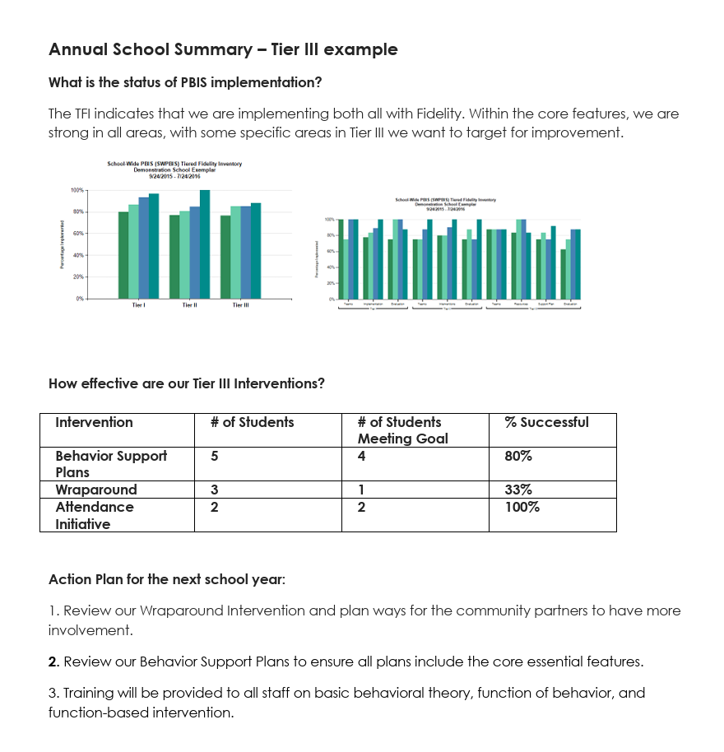
Example Evaluation: Tier 3
PBIS Annual Summary Example
Back to ALL ITEMS

Slide 42
3.15 Individual Support Team
Subscale: Individualized Support
For each individual support plan, a unique team exists to design, implement, monitor, and adapt the student-specific support, including input/approval from student/family about team membership and individuals who actively provide expertise in each relevant area: applied behavioral expertise mental health and trauma expertise access to external support agencies and resources for planning and implementing non-school-based interventions (e.g., intensive mental health) academic expertise physical health and wellness (e.g., nurse, health teacher) knowledge of data systems and information regarding system and student academic and SEB strengths and needs knowledge about the operations of the school across grade levels and programs
Possible Data Sources | A sample of 30% or a minimum of three randomly selected Tier 3 student behavior support plans created in the last 12 months (see TFI Tier 3 Support Plan Worksheet)
Main idea:
Each student receiving Tier 3 supports needs an individualized team comprised of relevant expertise and input.
Back to ALL ITEMS
Notes:
Audio:
The last set of Tier 3 items are under the subscale of Individualized Support and specifically detail actions to support individual students. It is important to note that to score this set of items, teams need access to current student support plans.
This describes the unique team that is needed to develop, implement, and monitor effectiveness for each individual support plan that is needed. Notice the emphasis on including input from the student and family about team membership.

Slide 43
3.15 Individual Support Team
0 | 1 | 2 | 3 | 4
Individual support teams do not exist for all students who need them. | Individual support teams exist, but student support teams do not include all relevant areas of expertise. | Individual support teams exist and include input/approval from student/family about who is on the team, and team includes some but not all relevant areas of expertise. | Individual support teams exist, include input/approval from student/family about who is on the team, and team includes all relevant areas of expertise for each student. | Individual support teams exist, include all relevant areas of expertise for each student, and all members are actively engaged in the design, implementation, and monitoring of student specific support plans with participation of all roles at or above 80%.
Reflective questions to focus the conversation: Is there an individual support team for each student who needs one? Do the teams include all relevant areas of expertise? Is input/approval garnered from the student and family? Do all members consistently participate in the design, implementation and monitoring of the student support plans?
Back to ALL ITEMS
Notes:
Audio
Scoring for this item is based on the number of characteristics met by the Tier 3 individual support teams that are in place. Teams will need to review a sample of 30% of their current plans (or a minimum of three randomly selected plans) in order to score this item and the items that follow. A resource to assist teams in this review can be found in Appendix D in the TFI 3.0 manual as is reviewed on the next slide.

Slide 44

Appendix C: Tier 3 Support Plan Worksheet
Randomly select 3 Tier 3 plans created I the last 12 months.
If only 1-2 plans exist, score the TFI feature at the highest level for which all plans meet the criteria.
Review each plan separately
Sum the total points for all plans
Convert the sum rating to a TFI score for each item
Back to ALL ITEMS
Notes:
Audio:
The TFI Tier 3 Support Plan Worksheet (located in Appendix D of the TFI 3.0 Manual) has been developed to assist teams as they review their existing Tier 3 student support plans. The worksheet allows teams to review and assign scores for each of the sample plans, and provides guidance to help teams translate these scores to TFI scores for each item in the Individualized Support section.
The directions at the top of the page provide guidance for teams who may be in different stages of student support plan implementation.
For teams who are completing the Tier 3 section of the TFI 3.0 for the first time, it may be purposeful to assemble the sample of Tier 3 plans and complete this worksheet as they process through each item in this slide deck. Teams with more familiarity of the TFI items may be able to complete this review ahead of completing the TFI 3.0

Slide 45
3.16 Individual Assessment Plans
Subscale: Individualized Support
Individual Support Teams (defined in item 3.15) follow comprehensive assessment protocol (defined in item 3.4) to document individualized comprehensive assessment for each student receiving Tier 3 support that includes all relevant data sources and each student specific element.
Possible Data Sources | A sample of 30% or a minimum of three randomly selected Tier 3 student behavior support plans created in the last 12 months (see TFI Tier 3 Support Plan Worksheet)
Main idea:
It is important that the comprehensive assessment protocol is followed for each student receiving Tier 3 supports.
Back to ALL ITEMS
Notes:
Audio:
The focus of this item is to ensure that the comprehensive assessment protocol (defined and assessed in TFI item 3.4) is used with fidelity for each student receiving Tier 3 support.

Slide 46
3.16 Individual Assessment Plans
0 | 1 | 2 | 3 | 4
Sampled comprehensive assessments do not follow a comprehensive assessment protocol and do not include elements of comprehensive assessment described in item 3.4 (i.e., strengths, precise statement of needs, hypothesis statement, and relevant additional information). | Some sampled comprehensive assessments follow a comprehensive assessment protocol and include observable, measurable, and specific descriptions of some, but not all, elements of comprehensive assessment described in item 3.4. | Each Student Support Team consistently uses Tier 3 comprehensive assessment protocol to conduct and document a comprehensive assessment plan and sampled comprehensive assessments include observable, measurable, and specific descriptions of all elements of comprehensive assessment described in item 3.4. | Each Student Support Team consistently uses Tier 3 comprehensive assessment protocol to conduct and document a comprehensive assessment plan and sampled comprehensive assessments include observable, measurable, and specific descriptions of all elements of comprehensive assessment described in item 3.4 and data to support some, but not all, elements. | Each Student Support Team consistently uses Tier 3 comprehensive assessment protocol to conduct and document a comprehensive assessment plan and sampled comprehensive assessments include observable, measurable, and specific descriptions of all elements of comprehensive assessment described in item 3.4 and data to support all elements.
Reflective questions to focus the conversation: How many of the sampled plans follow the assessment protocol? Do the plans include all elements of the assessment protocol? Is data used to support all elements of the protocol?
Back to ALL ITEMS
Notes:
Audio
Scoring of this item is based on the review of sample Tier 3 student plans and highlights the degree to which each plan meets the characteristics of comprehensive assessment, described in TFI item 3.4.
Teams can use the TFI Tier 3 Support Plan Worksheet (located in Appendix D of the TFI 3.0 manual) to assist in the review of Tier 3 plans.

Slide 47
3.17 Individual Support Plans
Subscale: Individualized Support
Individual Support Teams (defined in item 3.15) follow Tier 3 individual support plan protocols (defined in item 3.5) to document individualized support plans for all students receiving Tier 3 support.
Possible Data Sources | A sample of 30% or a minimum of three randomly selected Tier 3 student individual support plans created in the last 12 months (see TFI Tier 3 Support Plan Worksheet)
Main idea:
It is important that the support plan protocol is followed for each student receiving Tier 3 supports.
Back to ALL ITEMS
Notes:
Audio:
Similar to the previous item, this one focuses on the use of the support plan protocol (defined in TFI item 3.5) with students receiving Tier 3 support.

Slide 48
3.17 Individual Support Plans
0 | 1 | 2 | 3 | 4
Sampled individual support plans do not follow an individual support protocol and do not include elements a-g of individual support plan protocol described in item 3.5 (i.e., prevention strategies, teaching strategies, response strategies, safety when needed, a process for monitoring fidelity and impact, action plan). | Some sampled individual support plans follow an individual support plan protocol and include observable, measurable, and specific descriptions of some, but not all, elements a-g of individual support plan protocol described in item 3.5. | Each Student Support Team consistently uses an individual support plan protocol and sampled plans include observable, measurable, and specific descriptions of all elements a-g of individual support plan protocol described in item 3.5 but plans are not consistently based on a recent comprehensive assessment (e.g., do not match complexity/ intensity of need; do not address behavioral function; were not conducted within the past 12 months) | Each Student Support Team consistently uses an individual support plan protocol and sampled plans include observable, measurable, and specific descriptions of all elements a-g of individual support plan protocol described in item 3.5 and most but not all plans are based on a recent comprehensive assessment (e.g., match complexity/ intensity of need; address behavioral function; were conducted within the past 12 months) | Each Student Support Team consistently uses an individual support plan protocol and sampled plans include observable, measurable, and specific descriptions of all, elements a-g of individual support plan protocol described in item 3.5 and all plans are based on a recent comprehensive assessment (e.g., match complexity/ intensity of need; address behavioral function; were conducted within the past 12 months).
Reflective questions to focus the conversation: How many of the sampled plans follow the support plan protocol? Do the plans include all essential elements of the individual support plan protocol? Are the plans based on the results of a recent comprehensive assessment(s)?
Back to ALL ITEMS
Notes:
Audio
Scoring for this item is based on the review of sample Tier 3 student plans and highlights the degree to which each plan meets the characteristics of individualized support, described in TFI item 3.5.
Teams can use the TFI Tier 3 Support Plan Worksheet (located in Appendix D of the TFI 3.0 manual) to assist in the review of Tier 3 plans.

Slide 49
3.18 Individualized Support Plan Orientation & Training
Subscale: Individualized Support
A written process is followed for teaching all relevant staff, families, and students how to implement or support each individual support plan that is in place.
Possible Data Sources | A sample of 30% or a minimum of three randomly selected Tier 3 student individual support plans created in the last 12 months (see TFI Tier 3 Support Plan Worksheet)
Main idea:
All relevant staff, family members, and the student themselves need to know how to implement or support the plan that has been developed.
.
Back to ALL ITEMS
Notes:
Audio:
The focus of this item is to ensure that anyone supporting the student (both inside and outside of the school and including the student themselves) has the knowledge needed to implement the plan, as designed. This ensures high implementation fidelity, and contributes to a higher likelihood of success.

Slide 50
3.18 Individualized Support Plan Orientation & Training
0 | 1 | 2 | 3 | 4
No process in place to teach relevant staff, families, or students. | Informal process exists to teach relevant staff, families, and/or students. | Formal process exists to teach relevant staff, families, and/or students to implement/support some Tier 3 plans. | Formal process exists to teach relevant staff, families, and students to implement/support some Tier 3 plans. | Formal process to teach relevant staff, families, and students to implement/support all Tier 3 plans.
Reflective questions to focus the conversation: Is there a process in place to teach staff, families, and students about the student support plan? Is this process followed for all Tier 3 student support plans in place?
Back to ALL ITEMS
Notes:
Audio:
Scoring for this item is based on the degree to which relevant staff, families, and students have access to orientation and training about student support plans.
Teams can use the TFI Tier 3 Support Plan Worksheet (located in Appendix D of the TFI 3.0 manual) to assist in the review of Tier 3 plans.

Slide 51
3.19 Individualized Data-based Decision Making
Subscale: Name
Each Individualized Support Team meets at least monthly (or more frequently if needed) and uses data to modify the support plan across all relevant plan areas to improve fidelity of plan implementation and impact on quality of life, academic, SEB, and other relevant outcomes.
Possible Data Sources | A sample of 30% or a minimum of three randomly selected Tier 3 student behavior support plans created in the last 12 months (see TFI Tier 3 Support Plan Worksheet)
Main idea:
Teams need to regularly review fidelity and outcome data to identify how Tier 3 supports should be altered.
Back to ALL ITEMS
Notes:
Audio:
This item highlights the importance for each of the student support teams to meet at least monthly to review both fidelity and student outcome data. In short, teams need to frequently ask, “Is the support plan being implemented as designed,” and “Is the plan benefiting the student?”

Slide 52
3.19 Individualized Data-based Decision Making
0 | 1 | 2 | 3 | 4
There is no evidence that teams meet to monitor individualized support plan implementation fidelity or impact (i.e., academic, SEB, quality of life, other relevant outcomes). | Individual student teams inconsistently meet to monitor individualized support plan implementation fidelity and/or impact. | Individual student teams regularly meet (at least monthly) to monitor individualized support plan implementation fidelity and impact, but do not modify (i.e., intensify, change strategies, and/or fade) individualized support plan or implementation supports based on data. | Individual student teams regularly meet to monitor individualized support plan implementation fidelity and impact, and systematically modify individualized support plan and/or implementation supports based on data. | Individual student teams monitor individualized support plan implementation fidelity and impact, and systematically modify individualized support plan, and implementation supports based on data.
Reflective questions to focus the conversation: Are teams monitoring implementation fidelity of individual support plans? Are teams monitoring student impact of the individual support plans? Is fidelity and impact data used to make adjustments to Tier III supports?
Back to ALL ITEMS
Notes:
Audio
Full implementation of this item is characterized by the use of both fidelity and relevant student outcome data to monitor the impact of the support plan and make adjustments, if necessary. Adjustments could include modifications to intensity, maintain, or fade support.
Teams can use the TFI Tier 3 Support Plan Worksheet (located in Appendix D of the TFI 3.0 manual) to assist in the review of Tier 3 plans.

Slide 53
Questions?
Contact:
support@pbisapps.org
training@pbisapps.org
855-455-8194
Notes:
Thank you for reviewing the Tiered Fidelity Inventory 3.0 resource presentation. The purpose of this slide deck is to review the format of the Tier 2 section of the fidelity tool, provide clear steps for administration, and provide scoring guidance for school teams.
If you have further questions, please reach out to us at support@pbisapps.org, training@pbisapps.org, or give us a call at 855-455-8194

