Slide 1

Tiered Fidelity Inventory (TFI) 3.0:
Preparing and Scoring Tier 2 Items
Version 3.0
March 2025
Access the audio on the slides by clicking on the audio icon.
Notes:
Audio:
Welcome to the Tiered Fidelity Inventory 3.0 resource presentation. The purpose of this slide deck is to review the format of the fidelity tool, provide clear steps for administration, and provide scoring guidance for school teams.
As you did on this first slide, look for the audio icon on each slide to access the accompanying audio.

Slide 2

Purpose of this Resource:
Intended use: to prepare coaches and facilitators who will be guiding administration and use of the TFI with school teams.
Resource Components:
  Overview of the Tier 2 Administration Process
  Preparation for Tier 2 Administration
  Tier 2 Item Presentation
Links to resources outside of this presentation:
Tiered Fidelity Inventory 3.0 Tier 1 Administration
Tiered Fidelity Inventory 3.0 Tier 3 Administration
Notes:
Audio:
This resource has been created specifically for coaches and facilitators who will assist school teams as they complete the TFI 3.0.
In this presentation, we will provide an overview of the tier 2 administration process, directions for preparing to administer (including suggestions for readiness), and an item-by-item presentation with scoring guidance.
We anticipate that our audience may come to the 3.0 with varying levels of previous experience with fidelity measures and PBIS implementation. And, we expect that you may need to reference this resource multiple times, so links are available to help you navigate to the topics of most interest. A separate resource is available to support teams to administer the Tier 1 and 3 sections of the TFI.

Slide 3
Overview of the TFI
The Tiered Fidelity Inventory 3.0 is a measure of the extent to which school teams are applying core features of school-wide PBIS (SWPBIS).
The TFI 3.0 has three subscales:
  Tier I: 20 Items
  Tier II: 15 Items
  Tier III: 19 Items
Notes:
Audio:
The purpose of the PBIS Tiered Fidelity Inventory (TFI) 3.0 is to provide a valid, reliable, and efficient measure of the extent to which school personnel are applying the core features of school-wide positive behavioral interventions and supports (SWPBIS). The TFI is divided into three sections (Tier 1: Universal PBIS Features; Tier 2: Targeted PBIS Features; and Tier 3: Intensive PBIS Features). The TFI is intended to guide both initial implementation and sustained use of PBIS.
While each Tier of items can be used separately or in combination to assess the extent to which core features are in place, it is recommended that teams who intend to complete the Tier 2 items also complete the Tier 1 section to engage in a more well-rounded self-assessment.

Slide 4
TFI Tier 2 Administration Process
Completed by a school’s Leadership Team or Systems Planning Team
Completion with an External Coach recommended
More frequent administration for early implementors
Paper/pencil or PBISApps.org
There is no cost to complete the TFI
Notes:
Audio:
The TFI is completed by a school’s leadership Team or Systems Planning Team (typically 3-8 individuals including a building administrator and external coach or district coordinator), often with input from Tier 1, 2, and/or 3 teams if these are independent groups. It is strongly recommended that the TFI be completed with an external PBIS coach as a facilitator. Validity research on the TFI 3.0 shows that school teams are more accurate when an external coach facilitates TFI completion.
School teams are encouraged to self-assess PBIS implementation when they initially launch implementation of PBIS and then every third or fourth meeting until they reach fidelity across three consecutive administrations. Once fidelity on a tier is met, the team may choose to shift to annual TFI assessment to evaluate sustained implementation. Note that schools new to PBIS may start by using only the Tier 1 section of the TFI, and as they improve their implementation of Tier 1, they may add assessment of Tier 2 and/or Tier 3 features.
The TFI may be completed using paper and pencil or by accessing the forms on www.pbisapps.org. Any school working with a state PBIS coordinator may access the website, TFI content, and reports. The TFI may also be downloaded from www.pbis.org. There is no cost to use the TFI or its online scoring and reporting features

Slide 5

PBIS Assessment
PBIS Assessment is a free application available to help record your TFI 3.0 data online!
Click here for more information on PBIS Assessment

Slide 6
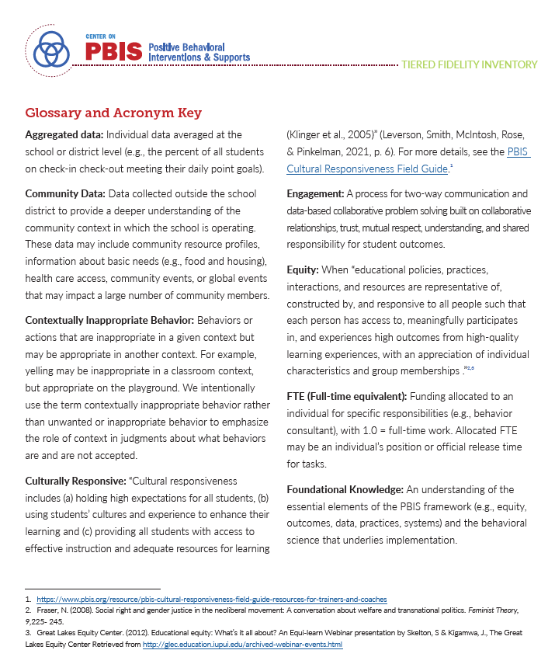
Glossary and Acronym Key
Notes:
Audio:
There may be terminology or acronyms used throughout the TFI that is unfamiliar to your team. You can reference the Glossary and Acronym Key in the manual for clarification.

Slide 7
Tier 2: Targeted Interventions
Click on each item you want to focus on, or go through the full set of slides:
Subscale: Teams | Subscale: Leadership Team Practices | Subscale: Systems | Subscale: Data
2.1 Team Composition 2.2 Team Operating Procedures | 2.3 Screening 2.4 Request for Assistance 2.5 Options for Tier 2 Interventions 2.6 Decision Rules for Assigning and Exiting Students for Intervention 2.7 Access to Tier 1 Supports | 2.8 Orientation and Training 2.9 Level of Use 2.10 Student Engagement 2.11 Family and Community Engagement 2.12 Faculty and Staff Engagement | 2.13 Decision Making with Student Performance Data 2.14 Decision Making with Fidelity Data 2.15 Evaluation Plan
Notes:
Audio
Tier 2 supports refers to the practices and systems that enable targeted interventions for students who are not successful with Tier 1 supports alone. The focus at Tier 2 is supporting students who are at risk for developing more serious unwanted behaviors before they start. Essentially, intervention at this level is more targeted than Tier 1 but less intensive than Tier 3.
Similar to the Tier 1 section, Tier 2 is also comprised of items related to Teams, Practices, Systems, and Data. The subscale scores are based on the scores of the items within the subscale. This format helps team engage in more precise progress monitoring and action planning.
You can view each item in order, or you can click on the particular items about which you’d like more information.

Slide 8
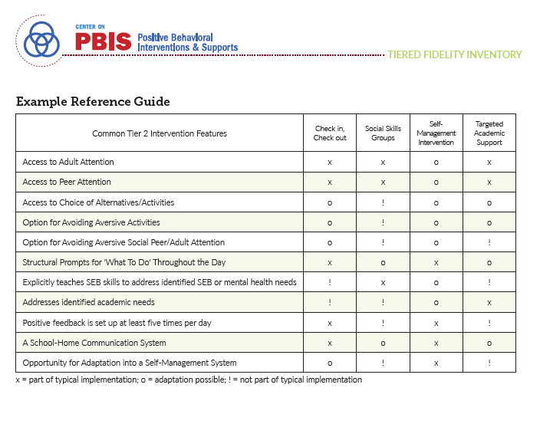
Preparation for Administration
Assemble or add relevant personnel
Increase familiarity with the Targeted Intervention Reference Guide (Appendix C)
Access the existing Tier II data (if in place)
Access the existing Annual Evaluation Plan
(if in place)
Notes:
Audio:
Completion of the Tier II TFI items requires knowledge of the existing functions and supports available to all students within the school. This may require additional or different personnel than the group who completed the Tier 1 items. It may also be beneficial to review the Targeted Interventions Reference Guide and Map (located in Appendix C of the TFI 3.0 manual). These resources will assist with scoring several Tier 2 items.
We also recommend having access to the existing Tier II data and collection plan, and Annual Evaluation Plan, if these items are already in place. This will increase efficiency as the team assesses these components.

Slide 9
TFI Feature Number and Name
Subscale: Name
Feature Description
Possible Data Sources
Main idea:
An explanation of the main idea for this feature
Notes:
Audio:
As teams sit down to complete the TFI, they will read through each item and rate themselves based on identified scoring criteria. Throughout this presentation, each item of the TFI is described in this format: At the top of the slide is the item name and number. The subscale that the item is associated with is in the top row of the chart. Below that is the item description and the possible data sources that can assist in scoring. Included is also a main idea statement that summarizes the main purpose of the item and how it relates to the bigger picture of PBIS implementation.

Slide 10
TFI Feature Number and Name
0 | 1 | 2 | 3 | 4
Scoring criteria for a score of 0. | Scoring criteria for a score of 1. | Scoring criteria for a score of 2. | Scoring criteria for a score of 3. | Scoring Criteria for a score of 4.
Reflective questions to focus the conversation: Question Documentation Process
Notes:
Audio
For each item, there will also be a scoring slide to assist the team in scoring the item. With some of the items, there will also be a slide including additional considerations or guiding reflection questions to help guide team consensus for the item. You’ll notice that the new TFI has an expanded, 5-point scale.

Slide 11
2.1 Team Composition
Subscale: Team
Tier 2 leadership team (or Tier 2 and 3 combined team) includes the following roles: 1-2 Tier 2 system coordinators (e.g., coaches), a school administrator, a representative group of educators (e.g., grade level or departmental representation, general and special education, certified and non-certified staff), members from marginalized groups, relevant community partners (e.g., mental health providers), and individuals who actively provide expertise the following areas: applied behavior support mental health and trauma academic instruction coaching equity physical health and wellness (e.g., nurse, health teacher) data systems and information regarding system and student academic and SEB strengths and needs operations of the school across grade levels and programs
Possible Data Sources | School organizational chart Tier 2 team meeting minutes
Main idea:
Tier 2 team needs individuals with specific skills and perspectives to implement Tier 2 supports.
Back to ALL ITEMS
Notes:
Audio:
The first item describes an effective tier 2 leadership team. The item specifically lists the type of expertise that should have representation on the team. Members from marginalized groups and relevant community partners are essential to the team.

Slide 12
2.1 Team Composition
0 | 1 | 2 | 3 | 4
Team does not exist or does not include a coordinator, school administrator, or individuals with applied behavioral expertise. | Team exists, but does not include all identified roles, or participation of these members is below 80%. | Team with all roles exists and is actively engaged with participation of all roles at or above 80%. | Team with all roles exists, is actively engaged with participation of all roles at or above 80%, and either a written process is followed for selecting, orienting, recruiting, and retaining team members or Tier 2 leadership team includes members from the group that is most exposed to disparate outcomes in this school (e.g., exclusionary discipline, bullying, mental health referrals) | Team with all roles exists, is actively engaged with participation of all roles at or above 80%, and both a written process is followed for selecting, orienting, recruiting, and retaining team members and Tier 2 leadership team includes members from the group that is most exposed to disparate outcomes in this school
Team Roles Assessment: are all necessary roles/functions represented on the team? Applied behavior support Mental health and trauma Academic instruction Coaching Equity Physical health and wellness Data systems information Operations of the school across grades and programs
Back to ALL ITEMS
Notes:
Audio:
Scoring for this item is based on the representation of roles, consistent participation in meetings, and processes for recruiting, orienting, and retaining team members. The team should include the roles in the checklist. One person may provide more than one role/perspective. For example, someone with behavioral expertise may also provide coaching.
The Tier II team does not need to be large. Even 2-5 people may be sufficient. The key is to ensure that the authority to make decisions exists, and the behavioral expertise is present to guide adaptations.

Slide 13
2.2 Team Operating Procedures
Subscale: Team
Tier 2 leadership team has (a) regular meeting format/agenda, that prompts the regular review of Tier 2 practices, systems, and data, (b) established and regularly used team norms, (c) defined meeting roles (e.g., timekeeper, facilitator, recorder), (d) regular (e.g., quarterly) two-way data sharing and communication with Tier 1 and Tier 3 teams to inform decision making, (e) a current action plan, (f) procedure for evaluating fidelity of team operating procedures (e.g., Team Initiated Problem Solving [TIPS] Fidelity Checklist) at least twice annually, (g) a formal process to monitor the impact of team norms and (h) procedures on ensuring all team members are able to participate as equal partners.
Possible Data Sources | Tier 2 team meeting agendas and minutes Tier 2 meeting roles descriptions Tier 2 action plan Team Initiated Problem Solving (TIPS) fidelity checklist items 1-9
Main idea:
Tier 2 teams need meeting foundations in order operate efficiently and to implement effective supports.
Back to ALL ITEMS
Notes:
Audio:
This Item focuses on the team operating procedures that will assist the team to run efficient and effective meetings. The main idea is that teams utilize operating procedures that will ensure teams effectively action plan and track progress during their meetings.

Slide 14
2.2 Team Operating Procedures
0 | 1 | 2 | 3 | 4
Team does not meet monthly, use regular meeting format/agenda, minutes, defined roles, or a current action plan. | Team meets at least monthly and has at least three but not all six of the procedures listed a-f. | Team meets at least monthly and has at least four but not all six of the procedures listed a-f. | Team meets at least monthly and has at least five but not all six of the procedures listed a-f, and either g or h. | Team meets at least monthly and has all eight of the procedures listed a-h.
Team Assessment: Regular, monthly meetings Team norms established Defined meeting roles Two-way data sharing with Tier 1 and 3 teams Current action plan Procedure for evaluating fidelity of team operating procedures and norms Procedure to ensure equal participation of team members
Back to ALL ITEMS
Notes:
Audio:
Scoring for this item is based on the number of procedures that are in place. Use the checklist to help determine what is currently in place and specific ways to strengthen team operations.
For schools whose Tier II team may be part of Tier I team, considerations are needed to ensure effectiveness during meetings, including a designated time to focus specifically on Tier 2 data review and review of student nomination. Keep in mind that this type of data may not be appropriate for the entire Tier 1 team audience.

Slide 15
2.3 Screening
Subscale: Leadership Team Practices
Tier 2 leadership team uses decision rules and multiple sources of data (e.g., discipline referrals, academic progress, screening tools, attendance, nominations), available from multiple informants (e.g., teacher, family, student), at multiple points in time (e.g., screening at identified points, on-going data review, on-going access to nomination process) to identify students who require Tier 2 internalizing or externalizing supports and to inform the modification or intensification of Tier 1 supports as needed.
Possible Data Sources | Multiple data sources used (e.g., discipline referrals, time out of instruction, attendance, academic performance) Team decision rubric Team meeting minutes School policy
Main idea:
Timely and accurate identification of students in need of Tier 2 supports improves the effectiveness of Tier 2 implementation
Back to ALL ITEMS
Notes:
Audio:
The focus of this item is on the established process that supports the identification of students who require intensive supports and also to help inform where Tier 1 supports may need to be modified or intensified.

Slide 16
2.3 Screening
0 | 1 | 2 | 3 | 4
No specific rules exist for identifying students who qualify for Tier 2 supports. | Decision rules are established but not consistently followed. | Decision rules are established but the team uses only one of the following: multiple data sources, multiple informant options, or multiple points in time. | Decision rules are established but the team uses only two of the following: multiple data sources, multiple informant options, or multiple points in time, and aggregate data is shared with the Tier 1 team to inform modification or intensification Tier 1 practices. | Decision rules are established with the team using all of the following: multiple data sources, multiple informant options, and multiple points in time, and aggregate data is shared with the Tier 1 team to inform modification or intensification Tier 1 practices.
Reflective questions to focus the conversation: Have decision rules been established and consistently followed? Does the team draw from multiple data sources? Does the team draw from multiple informants? Is the data representative of multiple timepoints? Is aggregated data shared with the Tier 1 team?
Back to ALL ITEMS
Notes:
Audio:
Scoring for this items is based on the number of criteria met in the checklist. Notice the emphasis on aggregate data shared with the Tier 1 team to guide modification and intensification of tier 1 practices.

Slide 17
2.4 Request for Assistance
Subscale: Leadership Team Practices
Tier 2 leadership team uses a written request for assistance form and process that are timely and available and accessible to all staff, families, and students.
Possible Data Sources | School handbook Request for assistance form Family handbook
Main idea:
Faculty, staff, families, and students should have a highly predictable and low-effort strategy for requesting assistance.
Back to ALL ITEMS
Notes:
Audio:
At the core of this item is the way that staff, families, and students can request assistance in ways that are timely and accessible for all.

Slide 18
2.4 Request for Assistance
0 | 1 | 2 | 3 | 4
There is no request for assistance process. | A written request for assistance form and process are in place but are not available to all staff, or the team’s response is not timely (longer than 3 days). | A written request for assistance form and process are in place and is available to all staff, and the team’s response is timely (within 3 days). | A written request for assistance form and process are in place, is available and accessible (e.g., most common home languages) to all staff, families, and students, and the team’s response is timely (within 3 days). | A written request for assistance form and process are in place, is available and accessible (e.g., most common home languages) to all staff, families, and students, the team’s response is timely (within 3 days), and administrator reports consistent use.
Reflective questions to focus the conversation: Is there a written process for requesting assistance? Does the process include a team response with a quick turnaround? Do all staff have access to this process? Is the process accessible for families and students?
Back to ALL ITEMS
Notes:
Audio:
Scoring for this item is based on the degree to which the characteristics related to the request for assistance process are in place and functioning. In addition to what is listed, the process for nominating a student should be easily understood and easily accessed by all. Emphasis should be given on having quick access to needed supports. It is important for teams to note that actions related to orientation and training of this process is linked to TFI item 2.8.

Slide 19
2.5 Options for Tier II Interventions
Subscale: Leadership Team Practices
Tier 2 continuum has multiple ongoing SEB support interventions available schoolwide that meet a range of student SEB internalizing or externalizing needs and behavioral functions, are designed to support groups of students, have documented evidence of effectiveness, and provide (a) additional instruction/time for student skill development, (b) additional structure/predictability, (c) increased opportunity for feedback (e.g., daily progress report), (d) increased communication with families, and (e) include planned modifications to address a range of behavioral function, mental health needs, or academic skills.
Possible Data Sources | School Tier 2 handbook Targeted Interventions Reference Guide
Main idea:
A wide array of intervention options increases the likelihood that student
needs are met and done so in a timely way..
Back to ALL ITEMS
Notes:
Audio:
While the previous item focused on the process for identifying students who may require intensified supports, this item focuses on the specific interventions available for students. The item specifically identified interventions that are evidence-based and well-suited to respond to a range of internalizing or externalizing social, emotional, or behavioral needs.

Slide 20
2.5 Options for Tier II Interventions
0 | 1 | 2 | 3 | 4
No Tier 2 interventions are in use or interventions do not include all four critical features. | Only 1 Tier 2 intervention with all critical features and documented evidence of effectiveness is in use. | Multiple Tier 2 interventions with all critical features and documented evidence of effectiveness are in use. | Multiple Tier 2 interventions with all critical features and documented evidence of effectiveness are in use, and interventions are available to meet behavioral functions and both internalizing or externalizing needs. | Multiple Tier 2 interventions with all critical features and documented evidence of effectiveness are in use, interventions are available to meet behavioral functions and both internalizing or externalizing needs, and planned adaptations are documented for relevant interventions (e.g., CICO modified to support students with escape maintained behaviors, skills group modified to prompt coping strategies to address anxiety)
Reflective questions to focus the conversation: What SEB support interventions are available schoolwide? Do the interventions meet the critical features? Instruction/time for student skill development Additional structure/predictability Increased opportunity for feedback Increased communication with families Include planned modifications Do the interventions meet behavioral functions and internal and externalizing behaviors?
Back to ALL ITEMS
Notes:
Audio:
The item lists five critical features of effective interventions which will drive scoring. Scoring is based on the numbers of interventions in place that meet these critical features, if available interventions can address both internalizing and externalizing behavior(s), and if any planned adaptations are documented. To determine this, teams will need to have a shared understanding of available interventions and review each intervention individually.
Appendix C (reviewed on the next slide) may be a beneficial resource for your team to complete these actions.

Slide 21
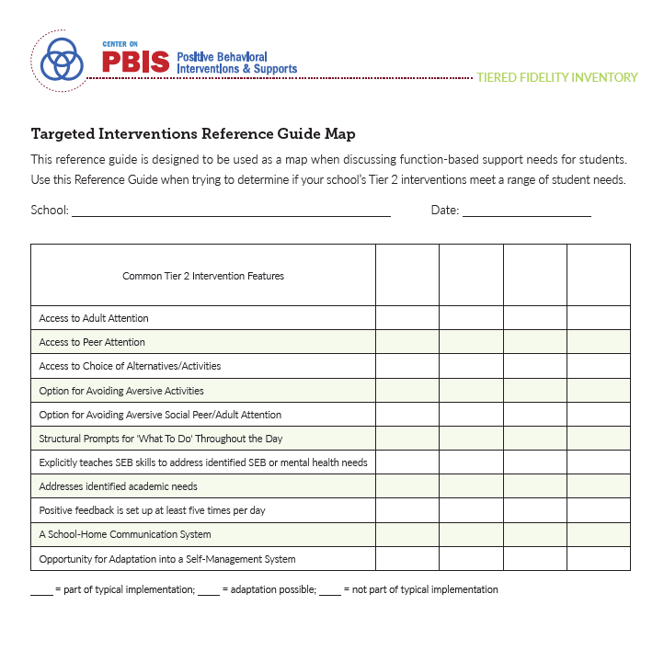
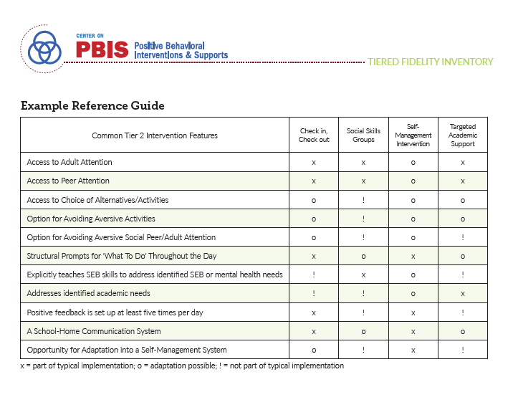
Tier II: Targeted Interventions Reference Guide (Appendix C)
Back to ALL ITEMS
Notes:
Audio:
The Targeted Interventions Reference Guide, located in Appendix C of the TFI 3.0 Manual is designed to be used as a map when discussing function-based support needs for students. It can also serve as a source of information for teams as they complete TFI items 2.5 and 2.6.
Teams can list the targeted interventions and assess the degree to which they meet critical intervention features. Similarly, teams can use the resource to assess the degree to which the available interventions meet the array of functional needs.

Slide 22
2.5 Options for Tier II Interventions Considerations
Standard modifications of existing interventions meet criteria for multiple interventions.
  CICO for peer attention
  CICO for academic task avoidance
Many approaches for Tier II support exist.
Focus on Tier II supports that improve student success (e.g., do more than simply remove or control the student).
Combinations of support strategies may be very appropriate and efficient.
Back to ALL ITEMS
Notes:
Audio:
Here are some additional considerations as teams review and strengthen their use of tier 2 supports.

Slide 23
2.6 Decision Rules for Assigning & Existing Students for Intervention
Subscale: Leadership Team Practices
A written process and set of decision rules is used for (a) matching students to Tier 2 interventions that are aligned to student need, cultural fit, and family and student preference and (b) exiting students from intervention after reaching pre-determined levels of performance.
Possible Data Sources | Data sources used to identify interventions School policy Tier 2 handbook Needs assessment Targeted Interventions Reference Guide
Main idea:
A Tier 2 support is more likely to be effective when it specifically matches student need.
Back to ALL ITEMS
Notes:
Audio:
While the previous item focused on the interventions that are available schoolwide, this item focuses on matching interventions to students based on need and procedures for existing students when they meet a specified level of performance. Notice the emphasis on cultural fit and family and student preference. These are critical features for a team’s decision rules.

Slide 24
2.6 Decision Rules for Assigning & Existing Students for Intervention
0 | 1 | 2 | 3 | 4
No process in place | Informal process for selecting and exiting students for Tier 2 interventions occurs but is not documented. | A written process for selecting and exiting students for Tier 2 interventions is used, but does not describe how interventions are matched to student need, cultural fit, and aligned with family and student preference. | A written process is used for selecting and exiting students for Tier 2 interventions that are matched to student need, cultural fit, and aligned with family and student preference. | A written process is used for selecting and exiting students for Tier 2 interventions that are matched to student need, cultural fit, and aligned with family and student preference and a written process is used to monitor, assess, and improve student match to intervention as needed.
Reflective questions to focus the conversation: Is there a written process for matching and/or existing students to interventions? Does the process include consideration of cultural fit and preference? Does the process include monitoring and assessment to improve student match as needed?
Back to ALL ITEMS
Notes:
Audio:
Scoring for this item is based on the characteristics outlined in the checklist.
Be sure to utilize the Targeted Interventions Reference guide (reviewed on the previous slides and located in Appendix C) as a resource when assessing or strengthening your decision rules.

Slide 25
2.7 Access to Tier 1 Supports
Subscale: Leadership Team Practices
Tier 2 supports are explicitly linked to Tier 1 supports (items 1.3-1.10), and students receiving Tier 2 supports have access to and are included in Tier 1 supports.
Possible Data Sources | Data demonstrating student access to Tier 1 expectations lesson plans, teaching schedules and Tier 1 acknowledgement systems Tier 2 lesson plans Family communication
Main idea:
Tier 2 supports are more effective when layered within Tier I.
Back to ALL ITEMS
Notes:
Audio:
Item 2.7 drives team actions to ensure that students who are participating in tier 2 supports continue to have access to tier 1 supports. This is important because we can increase the impact of tier 2 supports by layering within Tier 1 foundations. This item references Tier 1 items which include teaching and acknowledging schoolwide expectations, access to the schoolwide acknowledgement system, effective response strategies when behavior expectations are not met, and effective classroom practices.

Slide 26
2.7 Access to Tier 1 Supports
0 | 1 | 2 | 3 | 4
No evidence exists that students receiving Tier 2 interventions have access to Tier 1 supports. | Teams collect and review evidence to show students have some (not full) access to Tier 1 supports. | Evidence shows students have full access to (i.e., students are not excluded) Tier 1 supports, but Tier 2 interventions are not explicitly linked (e.g., intensify existing Tier 1 supports or use same language) to Tier 1 supports. | Evidence shows students have full access to Tier 1 supports, and most Tier 2 interventions are explicitly linked (e.g., intensify existing Tier 1 supports or use same language) to Tier 1 supports. | Evidence shows students have full access to Tier 1 supports, and all Tier 2 interventions are explicitly linked (e.g., intensify existing Tier 1 supports or use same language) to Tier 1 supports.
Reflective questions to focus the conversation: What evidence does the team have related to access to Tier I supports? Are the school’s Tier II supports linked/layered/aligned with the school-wide universal system?
Back to ALL ITEMS
Notes:
Audio:
Scoring for this item is based on the level of access to tier 1 supports for students who are receiving tier II interventions and the degree to which the tier II interventions are linked to tier 1 foundations. An example of this linkage could be the use of school-wide expectations in a student’s Check-in/Check-Out score sheet.

Slide 27
2.8 Orientation and Training
Subscale: Systems
A written process is used for teaching all relevant staff, families, and students how to (a) request assistance and (b) implement or support each Tier 2 intervention that is in place.
Possible Data Sources | Professional development calendar Staff/Family handbook Staff/Family orientation Lesson plans for teacher trainings School policy
Main idea:
Effective Tier 2 supports require adults in the school, families, and students to know how to request assistance and how to implement them.
Back to ALL ITEMS
Notes:
Audio:
The focus of this item is the explicit teaching to all relevant staff, families, and students both how to request assistance and also implement the tier 2 intervention as designed.

Slide 28
2.8 Orientation and Training
0 | 1 | 2 | 3 | 4
No process is in place to teach relevant staff, families, and/or students to (a) request assistance and/or (b) implement/support Tier 2 interventions. | Informal process exists to teach relevant staff, families, and/or students to (a) request assistance and/or (b) implement/support Tier 2 interventions. | A written process is used to teach relevant staff, families, and/or students to (a) request assistance and/or (b) implement/ support some Tier 2 interventions. | A written process is used to teach relevant staff, families, and students to (a) request assistance and (b) implement/ support some Tier 2 interventions. | A written process is used to teach relevant staff, families, and students to (a) request assistance and (b) implement/ support all Tier 2 interventions,
Reflective questions to focus the conversation: Is there a written process in place to orient and train key people? Are there scheduled trainings for school team members? Do students and parents have access to training? Do the trainings address all of the Tier 2 interventions available?
Back to ALL ITEMS
Notes:
Audio:
Scoring for this item is based on the characteristics related to orientation and training of the request for assistance process and the implementation of the Tier 2 interventions used in the school. While teams strengthen their training approach, be sure to build into the plan opportunities for new staff, volunteers, and families new to the school to access the trainings. Also, it may be purposeful to plan a school-wide orientation to Tier 2 as a starting point.

Slide 29
2.9 Level of Use
Subscale: Systems
Tier 2 leadership team follows written process to track proportion of students participating and experiencing success in Tier 2 supports, determining if access is appropriate (i.e., % of total student population supported by Tier 2 is reasonable given context), and equitable (i.e., disaggregated data demonstrate equitable representation in Tier 2 support by group [e.g., race/ethnicity, IEP/504, language status, gender]) and disaggregated data are used for decision making and shared with Tier 1 and Tier 3 teams to inform distribution of tiered supports.
Possible Data Sources | Tier 2 enrollment data Tier 2 team meeting minutes Progress monitoring tools Action Plan Staff feedback
Main idea:
Tier 2 supports that are used by
too few students (e.g., 1% of enrollment)
or by too many students (e.g., 20% of
enrollment) are not sustainable.
Back to ALL ITEMS
Notes:
Audio:
The level of use item for Tier 2 encourages teams to monitor and track the number of students participating in Tier 2 supports and consider if that number is appropriate based on the total school population or context and is equitable across student subgroups. Similarly, teams monitor the success of students accessing tier 2 supports and ask questions about their data to identify any disproportionate participation or outcomes. Lastly, the item includes sharing of this data with Tier I and 3 teams.

Slide 30
2.9 Level of Use
0 | 1 | 2 | 3 | 4
Team does not have criteria for or track the number of students participating or experiencing success in Tier 2 interventions. | Team has defined criteria for counting a student as participating and experiencing success in Tier 2 and uses criteria to report the number and percentage of students participating and experiencing success in Tier 2 interventions overall to Tier 1 and 3 teams at least annually. | Team has defined criteria for counting a student as participating and experiencing success in Tier 2 and uses criteria to report the number and percentage of students participating and experiencing success in Tier 2 interventions overall and by group to Tier 1 and 3 teams at least annually | Team has defined criteria for counting a student as participating and experiencing success in Tier 2 and uses criteria to report the number and percentage of students participating and experiencing success in Tier 2 interventions overall and by group and examines data to determine whether access is appropriate and equitable and shares data with Tier 1 and 3 teams at least annually. | Team has defined criteria for counting a student as participating and experiencing success in Tier 2 and uses criteria to report the number and percentage of students participating and experiencing success in Tier 2 interventions overall and by group and examines data to determine whether access is appropriate and equitable and shares data with Tier 1 and 3 teams at least quarterly.
Reflective questions to focus the conversation: Is participation and success in Tier II supports currently tracked? Is the criteria for counting a student as participating clearly defined? Are the data disaggregated and reviewed for disproportionality? Is participation appropriate and equitable? Is the data regularly shared with the Tier I and III teams?
Back to ALL ITEMS
Notes:
Audio:
Scoring for this item is based on the characteristics in the checklist. Note that full implementation specifies quarterly data sharing with Tier 1 and III teams. Generally, the level of Tier II supports should be between 5% and 15% of the total student population to be effective and worth the organizational costs.

Slide 31
2.10 Student Engagement
Subscale: Systems
Tier 2 leadership team purposefully and regularly engages students that are representative of the schools’ demographics and any marginalized groups in the regular review of schoolwide and community data in order to identify systemic barriers that may contribute to over or under representation of student groups in Tier 2 supports, and co-design and actively revise the selection and adaptation Tier 2 interventions and the implementation of Tier 2 foundational practices (items 2.3-2.9).
Possible Data Sources | Surveys Team meeting minutes
Main idea:
Implementation will be more effective and culturally responsive with active engagement from students.
Back to ALL ITEMS
Notes:
Audio:
The focus of this item are the actions tier II teams take to purposefully engage students in the implementation of Tier II supports. Engaging students helps teams identify systematic barriers that may lead to disproportionate representation and strengthen the Tier II foundational practices identified in TFI items 2.3 -2.9.

Slide 32
2.10 Student Engagement
0 | 1 | 2 | 3 | 4
No documentation or no opportunities exist for students to engage in examining data or developing/revising foundational Tier 2 practices. | Some students are engaged in providing input on some foundational Tier 2 practices based on a review of school and community data, within the past 12 months. | A representative group(s) of students is actively engaged in the selection and interpretation of school and community data to identify potential systemic barriers and provide input on the selection, implementation, and adaptation of some foundational Tier 2 practices and interventions within the past 12 months. | A representative group(s) of students is actively engaged in the selection and interpretation of school and community data to identify potential systemic barriers and provide input on the selection, implementation, and adaptation of all foundational Tier 2 practices and interventions within the past 12 months, and if data indicate a problem, an action plan is developed to enhance or modify foundational Tier 2 practices. | A representative group(s) of students is actively engaged in the selection and interpretation of school and community data to identify potential systemic barriers and provide input on the selection, implementation, and adaptation of all foundational Tier 2 practices and interventions at least twice per year, and if data indicate a problem, an action plan is developed to enhance or modify foundational Tier 2 practices.
Reflective questions to focus the conversation: What opportunities exist for students to examine data or provide feedback on Tier II practices? Is student voice representative of the school community and include marginalized groups? Do these actions happen consistently?
Back to ALL ITEMS
Notes:
Scoring for this item is based on the criteria in the reflective questions. Higher scores are obtained when teams engage with a representative sample of students that results in purposeful action planning at least twice per year.

Slide 33
2.11 Family and Community Engagement
Subscale: Systems
Tier 2 leadership team purposefully and regularly engages families and community members that are representative of the school’s demographics and (b) any marginalized groups in the regular review of schoolwide and community data in order to identify systemic barriers that may contribute to over or under representation of student groups in Tier 2 supports, and co-design and actively revise the selection and adaptation Tier 2 interventions and the implementation of Tier 2 foundational practices (items 2.3-2.9).
Possible Data Sources | Surveys Team meetings
Main idea:
Implementation will be more effective and culturally responsive with active engagement from family and community members.
.
Back to ALL ITEMS
Notes:
Audio:
Similar to the previous item, 2.11 focus on the engagement of family and community members who are representative of the school community, including marginalized groups. Engagement with these partners helps teams identify systematic barriers that may lead to disproportionate representation and strengthen the Tier II foundational practices identified in TFI items 2.3 -2.9.

Slide 34
2.11 Family and Community Engagement
0 | 1 | 2 | 3 | 4
No documentation or no opportunities exist for families and community members to engage in examining data or developing/revising Tier 2 practices. | Some families and community members are engaged in providing input on some foundational Tier 2 practices based on a review of school and community data, within the past 12 months. | A representative group(s) of families and community members is actively engaged in the selection and interpretation of school and community data to identify potential systemic barriers and provide input on the selection, implementation, and adaptation of some foundational Tier 2 practices and interventions within the past 12 months. | A representative group(s) of families and community members is actively engaged in the selection and interpretation of school and community data to identify potential systemic barriers and provide input on the selection, implementation, and adaptation of all foundational Tier 2 practices and interventions within the past 12 months, and if data indicate a problem, an action plan is developed to enhance or modify foundational Tier 2 practices. | A representative group(s) of families and community members is actively engaged in the selection and interpretation of school and community data to identify potential systemic barriers and provide input on the selection, implementation, and adaptation of all foundational Tier 2 practices and interventions at least twice per year, and if data indicate a problem, an action plan is developed to enhance or modify foundational Tier 2 practices.
Reflective questions to focus the conversation: What opportunities exist for these partners to examine data or provide feedback on Tier II practices? Are the voices of families and community partners representative of the school community and include marginalized groups? Do these actions happen consistently?
Back to ALL ITEMS
Notes:
Audio:
Scoring for this item is based on the criteria in the reflective questions. Higher scores are obtained when teams engage with a representative sample of students that results in purposeful action planning at least twice per year. Often, teams find that families and community members are able to provide access to information that is typically out of the reach of the schools and provide essential context, particularly when engaging in problem solving.

Slide 35
2.12 Faculty and Staff Engagement
Subscale: Systems
Tier 2 leadership team purposefully and regularly engages all faculty and staff in the regular review of schoolwide and community data in order to identify systemic barriers that may contribute to over or under representation of student groups in Tier 2 supports, and co-design and actively revise the selection and adaptation Tier 2 interventions and the implementation of Tier 2 foundational practices (items 2.3-2.9).
Possible Data Sources | Feedback and Input Survey (FIS) Informal Surveys Staff meeting minutes Team meeting minutes Social validity surveys Action plan
Main idea:
Schools need active engagement of faculty and staff to make Tier 2 supports effective and sustainable.
Back to ALL ITEMS
Notes:
Audio:
The third engagement item is focused on faculty and staff. Similar to student, parent and community partner engagement, the voices of all faculty and staff strengthen tier II implementation and help identify any barriers that may lead to disproportionality.

Slide 36
2.12 Faculty and Staff Engagement
0 | 1 | 2 | 3 | 4
No documentation or no opportunities exist for faculty and staff to engage in examining data or developing/revising foundational Tier 2 practices. | Faculty and staff are engaged in providing input on some foundational Tier 2 practices based on a review of school and community data, within the past 12 months. | Faculty and staff are actively engaged in the selection and interpretation of school and community data to identify potential systemic barriers and provide input on the selection, implementation, and adaptation of some foundational Tier 2 practices and interventions within the past 12 months. | Faculty and staff are actively engaged in the selection and interpretation of school and community data to identify potential systemic barriers AND provide input on the selection, implementation, and adaptation of all foundational Tier 2 practices and interventions within the past 12 months, and if data indicate a problem, an action plan is developed to enhance or modify foundational Tier 2 practices. | Faculty and staff are actively engaged in the selection and interpretation of school and community data to identify potential systemic barriers AND provide input on the selection, implementation, and adaptation of all foundational Tier 2 practices and interventions at least twice per year, and if data indicate a problem, an action plan is developed to enhance or modify foundational Tier 2 practices.
Reflective questions to focus the conversation: What opportunities exist for faculty and staff to examine data or provide feedback on Tier II practices? Do all faculty and staff have access to Tier II data and programming? Do these actions happen consistently?
Back to ALL ITEMS
Notes:
Audio:
Scoring or this item is based on the depth of engagement for faculty and staff on the school’s Tier II practices, data review, and action planning. Increased frequency of these actions are associated with higher scores.

Slide 37
2.13 Decision Making with Student Performance Data
Subscale: Data
Tier 2 leadership team establishes and uses decision rules and a written process for regular data review to (a) monitor benefit overall, by group, and for individual students and (b) adjust support (e.g., intensify, modify, or fade) to increase responsiveness.
Possible Data Sources | Student progress data (e.g., % of students meeting goals) Intervention Tracking Tool Daily/Weekly Progress Report sheets Family communication
Main idea:
Tier 2 team needs regular access
to information about student success to be
able to adapt and improve Tier 2 supports
.
Back to ALL ITEMS
Notes:
Audio:
This is the first item in the Tier II data subscale and it is focused on outcomes for students who are receiving Tier II supports. Notice that the data review includes disaggregation by group and individual students and the item includes a process for adjusting support to increase student responsiveness.

Slide 38
2.13 Decision Making with Student Performance Data
0 | 1 | 2 | 3 | 4
Team does not have a written process for monitoring student benefit in all Tier 2 interventions. | Team uses a written process for monitoring student benefit in all Tier 2 interventions and uses criteria to review the number and percent of students responding to Tier 2 interventions. | Team uses a written process for monitoring student benefit in all Tier 2 interventions and uses criteria to review the number and percent of students responding to Tier 2 interventions overall and by group (i.e., race/ethnicity, gender, disability). | Team uses a written process for monitoring student benefit in all Tier 2 interventions and uses criteria to (a) review the number and percent of students responding to Tier 2 interventions overall and by group (i.e., race/ethnicity, gender, disability) and (b) adjust support (e.g., intensify, modify, or fade) to increase responsiveness across some Tier 2 interventions. | Team uses a written process for monitoring student benefit in all Tier 2 interventions and uses criteria to (a) review the number and percent of students responding to Tier 2 interventions overall and by group (i.e., race/ethnicity, gender, disability) and (b) adjust support (e.g., intensify, modify, or fade) to increase responsiveness across all Tier 2 interventions.
Reflective questions to focus the conversation: Is there a system to collect and organize intervention outcome data? Can the data be disaggregated to monitor outcomes by both group and individual students? Does the Tier II team have access to reports summarizing intervention outcome data? Does the Tier II team have a system with data decision rules to identify how Tier II supports should be altered?
Back to ALL ITEMS
Notes:
Audio:
While this item is part of the data subscale, it relies on a systematic process to gather, review, and respond to data. Part of an effective response is to follow a written process to intensify, modify, or fade the support as necessary. It is important for teams to consider each Tier II intervention separately when planning modifications or adjustments. The next slide provides some resources to assist with Tier II data collection.

Slide 39
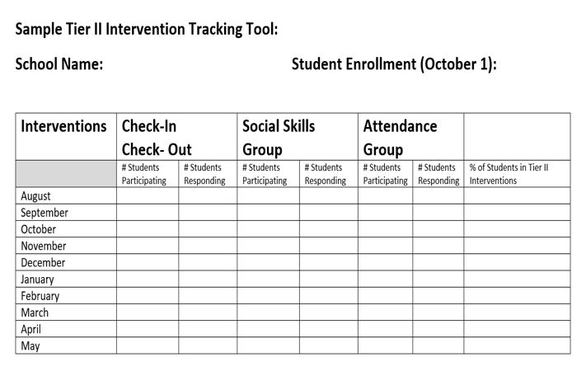
Student Performance Data Considerations
Having an efficient way to track student data will make the data more likely to be reviewed monthly.
Possible documentation includes an Intervention Tracking Tool. Here is one example. (There are many ways to track data: Excel, Word or Google Docs)
See more examples on pbisapps.org>Resources
Back to ALL ITEMS

Slide 40
2.14 Decision Making with Fidelity Data
Subscale: Data
Tier 2 leadership team uses a protocol for ongoing review of fidelity for each Tier 2 practice.
Possible Data Sources | Tier 2 coordinator meeting District technical assistance Fidelity probes taken monthly by Tier 2 team member Fidelity measures
Main idea:
Fidelity assessments should
always be included as part of
implementation practice.
Back to ALL ITEMS
Notes:
Audio:
This data item focuses on the fidelity of implementation of Tier II supports, or the degree to which the support is being delivered as planned. Fidelity is a critical component of successful outcomes for Tier II implementation, particularly when making decisions about adjustments or modifications. Simply put, if the interventions are not being delivered fully, we cannot make accurate conclusions about their effectiveness. Further, we cannot expect student outcomes without high fidelity of implementation.

Slide 41
2.14 Decision Making with Fidelity Data
0 | 1 | 2 | 3 | 4
No protocol exists to collect and review fidelity of each Tier 2 practice. | Informal approach used to monitor fidelity of each Tier 2 practice. | Protocol developed to collect and monitor fidelity data (e.g. direct, self-report) for Tier 2 practices, and is implemented for some but not all Tier 2 interventions. | Periodic, direct assessments of fidelity data are collected by Tier 2 team for all Tier 2 interventions in accordance with established protocol | Periodic, direct assessments of fidelity data are collected by Tier 2 team for all Tier 2 interventions in accordance with protocol, and used to make adjustments to implementation support.
Reflective questions to focus the conversation: Is there a protocol to collect and review Tier II fidelity? Is fidelity across all Tier II interventions assessed? Is fidelity data used to make adjustments to Tier II supports?
Back to ALL ITEMS
Notes:
Audio:
Full implementation of this item is characterized by the use of periodic fidelity assessment for all of the Tier II interventions that are in use, and use of that data to make adjustments to those supports. Teams may find it helpful to establish data routines to assist with this criteria. For example, one Tier 2 team member could be responsible for conducting monthly fidelity probes and bringing that information to the team.

Slide 42
2.15 Evaluation Plan
Subscale: Data
Tier 2 leadership team uses a written process to document the fidelity, effectiveness, and equitable use of Tier 2 practices at least annually (including year-by-year comparisons) that are (a) integrated with other data to inform overall school improvement efforts and (b) shared with partners (staff, families, community, district) in a usable format.
Possible Data Sources | Action plan School or district evaluation reports School newspapers School webpage
Main idea:
Any strategy or procedure needs to be reviewed at least annually and revised to remain current and match changes in the school.
Back to ALL ITEMS
Notes:
Audio:
The last Tier II data item is related to the evaluation plan, which documents the fidelity, effectiveness, and equitable use of the Tier II supports in place. Included in this item is the integration of this data with other data sources and sharing with staff, families, community partners, and with the district in ways that are usable.

Slide 43
2.15 Evaluation Plan
0 | 1 | 2 | 3 | 4
Tier 2 leadership team does not document fidelity and effectiveness of Tier 2 practices at least annually. | Tier 2 leadership team documents fidelity or effectiveness of Tier 2 practices at least annually. | Tier 2 leadership team documents fidelity and effectiveness of Tier 2 practices at least annually. | Tier 2 leadership team documents fidelity and effectiveness of Tier 2 practices at least annually and data is integrated with other data sources to inform overall school improvement efforts and partners are informed. | Tier 2 leadership team documents fidelity and effectiveness of Tier 2 practices at least annually and data is integrated with other data sources to inform overall school improvement efforts, partners are informed, clear action items and alterations are in process based on evaluation.
Reflective questions to focus the conversation: Is there an evaluation conducted for Tier II systems? Does the evaluation include both fidelity and effectiveness? Are the outcomes shared with all (families, staff, community, district)? Do the outcomes of the plan linked to action items?
Back to ALL ITEMS
Notes:
Audio:
Scoring for this item is based on measurement of both fidelity and effectiveness, the integration of other data, and communication with relevant partners. Further, the evaluation plan should be connected to clear action items or alternations to programming.

Slide 44
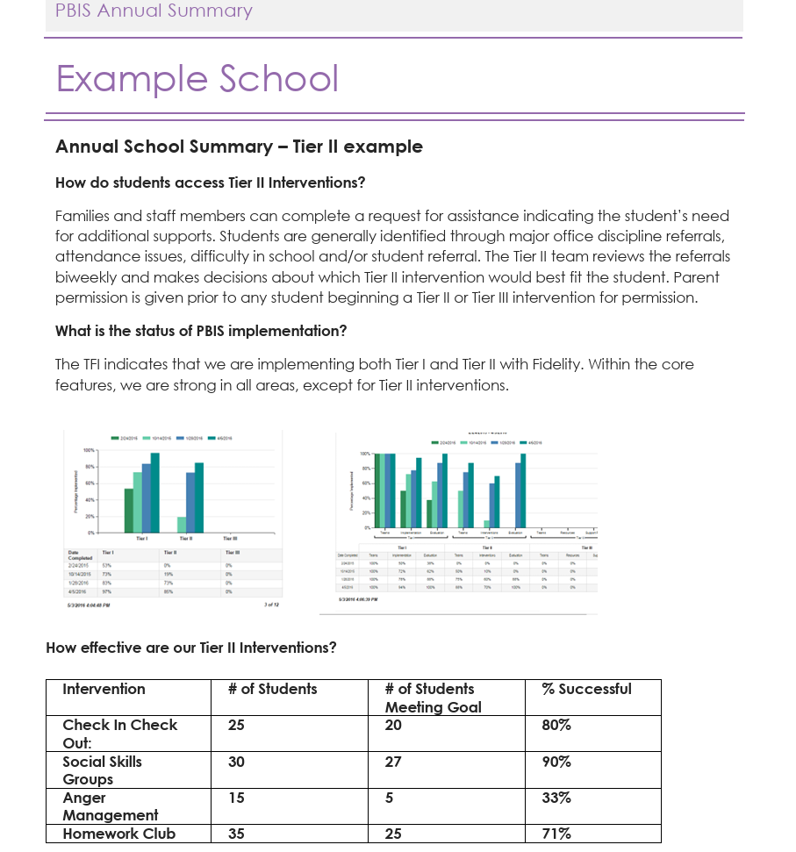
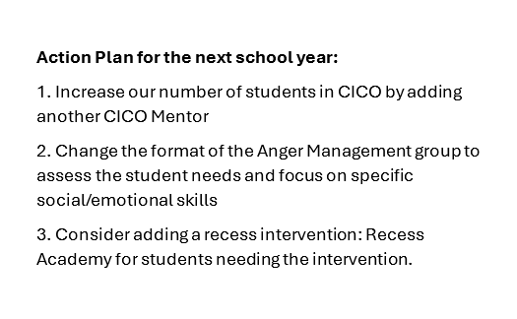
Example Tier II Annual Evaluation
PBIS Annual Summary Example
Back to ALL ITEMS
Notes:
Audio:
Here is an example of an Annual Tier II Evaluation Plan that addresses fidelity, effectiveness, and equitable use of Tier II practices.

Slide 45
Questions?
Contact:
support@pbisapps.org
training@pbisapps.org
855-455-8194
Notes:
Thank you for reviewing the Tiered Fidelity Inventory 3.0 resource presentation. The purpose of this slide deck is to review the format of the Tier 2 section of the fidelity tool, provide clear steps for administration, and provide scoring guidance for school teams.
If you have further questions, please reach out to us at support@pbisapps.org, training@pbisapps.org, or give us a call at 855-455-8194

