Slide 1

Tiered Fidelity Inventory (TFI) 3.0:
Preparing for Administration and
Scoring Tier 1 Items
Version 3.0
March 2025
Access the audio on the slides by clicking on the audio icon.
Notes:
Audio:
Welcome to the Tiered Fidelity Inventory 3.0 resource presentation. The purpose of this slide deck is to review the format of the fidelity tool, provide clear steps for administration, and provide scoring guidance for school teams.
As you did on this first slide, look for the audio icon on each slide to access the accompanying audio.

Slide 2

Purpose of this Resource:
Intended use: to prepare coaches and facilitators who will be guiding administration and use of the TFI with school teams.
Resource Components:
  Overview of the TFI
  Overview of the Administration Process
  Preparing to complete the 3.0
    TFI Walkthrough Interview and Observation Form
    Classroom Data Summary Worksheet
  Tier 1 Item Presentation
Links to resources outside of this presentation:
Tiered Fidelity Inventory 3.0 Tier 2 Administration
Tiered Fidelity Inventory 3.0 Tier 3 Administration
Notes:
Audio:
This resource has been created specifically for coaches and facilitators who will assist school teams as they complete the TFI 3.0.
In this presentation, we will provide an overview of the measure and the administration process, directions for preparing to administer the Tier 1 scale (including completing required readiness tasks), and an item-by-item presentation with scoring guidance.
We anticipate that our audience may come to the 3.0 with varying levels of previous experience with fidelity measures and PBIS implementation. And, we expect that you may need to reference this resource multiple times, so links are available to help you navigate to the topics of most interest. A separate resource is available to support teams to administer the Tier 2 and 3 sections of the TFI.

Slide 3

Overview of the TFI
The Tiered Fidelity Inventory 3.0 is a measure of the extent to which school teams are applying core features of school-wide PBIS (SWPBIS).
The TFI 3.0 has three scales:
  Tier I: 20 Items
  Tier II: 15 Items
  Tier III: 19 Items
Notes:
Audio:
The purpose of the PBIS Tiered Fidelity Inventory (TFI) 3.0 is to provide a valid, reliable, and efficient measure of the extent to which school personnel are applying the core features of school-wide positive behavioral interventions and supports (SWPBIS). The TFI is divided into three sections (Tier 1: Universal PBIS Features; Tier 2: Targeted PBIS Features; and Tier 3: Intensive PBIS Features) that can be used separately or in combination to assess the extent to which core features are in place. The TFI is intended to guide both initial implementation and sustained use of PBIS.

Slide 4
TFI Administration Process
Completed by a school’s Leadership Team or Systems Planning Team
Team comes to consensus for each score
Completion with an External Coach recommended
More frequent administration for early implementers
Can be completed with paper/pencil or on PBISApps.org
There is no cost to complete the TFI
Notes:
Audio:
The TFI is completed by a school’s leadership Team or Systems Planning Team (typically 3-8 individuals including a building administrator and external coach or district coordinator), often with input from Tier 1, 2, and/or 3 teams if these are independent groups. For each score, teams will need to come to a consensus. It is strongly recommended that the TFI be completed with an external PBIS coach as a facilitator. Validity research on the TFI 3.0 shows that school teams are more accurate when an external coach facilitates TFI completion.
School teams are encouraged to self-assess PBIS implementation when they initially launch implementation of PBIS and then every third or fourth meeting until they reach fidelity across three consecutive administrations. Once fidelity on a tier is met, the team may choose to shift to annual TFI assessment to evaluate sustained implementation. Note that schools new to PBIS may start by using only the Tier 1 section of the TFI, and as they improve their implementation of Tier 1, they may add assessment of Tier 2 and/or Tier 3 features.
The TFI may be completed using paper and pencil or by accessing the surveys on www.pbisapps.org. Any school working with a state PBIS coordinator, trainer or coach may access the website, TFI content, and reports. The TFI may also be downloaded from www.pbis.org. There is no cost to use the TFI or its online scoring and reporting features.

Slide 5

PBIS Assessment
PBIS Assessment is a free application available to help record your TFI 3.0 data online!
Click here for more information on PBIS Assessment

Slide 6
Glossary and Acronym Key
Notes:
Audio:
There may be terminology or acronyms used throughout the TFI that is unfamiliar to your team. You can reference the Glossary and Acronym Key in the manual for clarification.

Slide 7
Tier 1: Building a Strong Foundation
Click on each item you want to focus on, or go through the full set of slides:
Subscale: Teams | Subscale: Practices | Subscale: Systems | Subscale: Data
1.1: Team Composition 1.2: Team Operating Procedures | 1.3 Schoolwide Expectations 1.4 Schoolwide Expectations Taught 1.5 Schoolwide Acknowledgement 1.6 Contextually Inappropriate Behavior Definitions 1.7 Responses to Contextually Inappropriate Behavior 1.8 Crisis and Emergency Response Plan Linked to Schoolwide Supports 1.9 Schoolwide Practices used in Classrooms 1.10 Classroom Practices | 1.11 Established Priority 1.12 Schoolwide Professional Development & Coaching 1.13 Classroom Professional Development & Coaching 1.14 Faculty & Staff Engagement 1.15 Student Engagement 1.16 Family & Community Engagement | 1.17 Decision Making with Behavior Data 1.18 Using School and Community Data 1.19 Decision Making with Fidelity Data 1.20 Evaluation Plan
Notes:
Audio
Tier I is the foundation when implementing PBIS. Tier I focuses on Teams, Practices, Systems, and Data. The subscale scores are based on the scores of the items within the subscale. This format helps team engage in more precise progress monitoring and action planning. You can view each item in order, or you can click on the particular items about which you’d like more information.

Slide 8
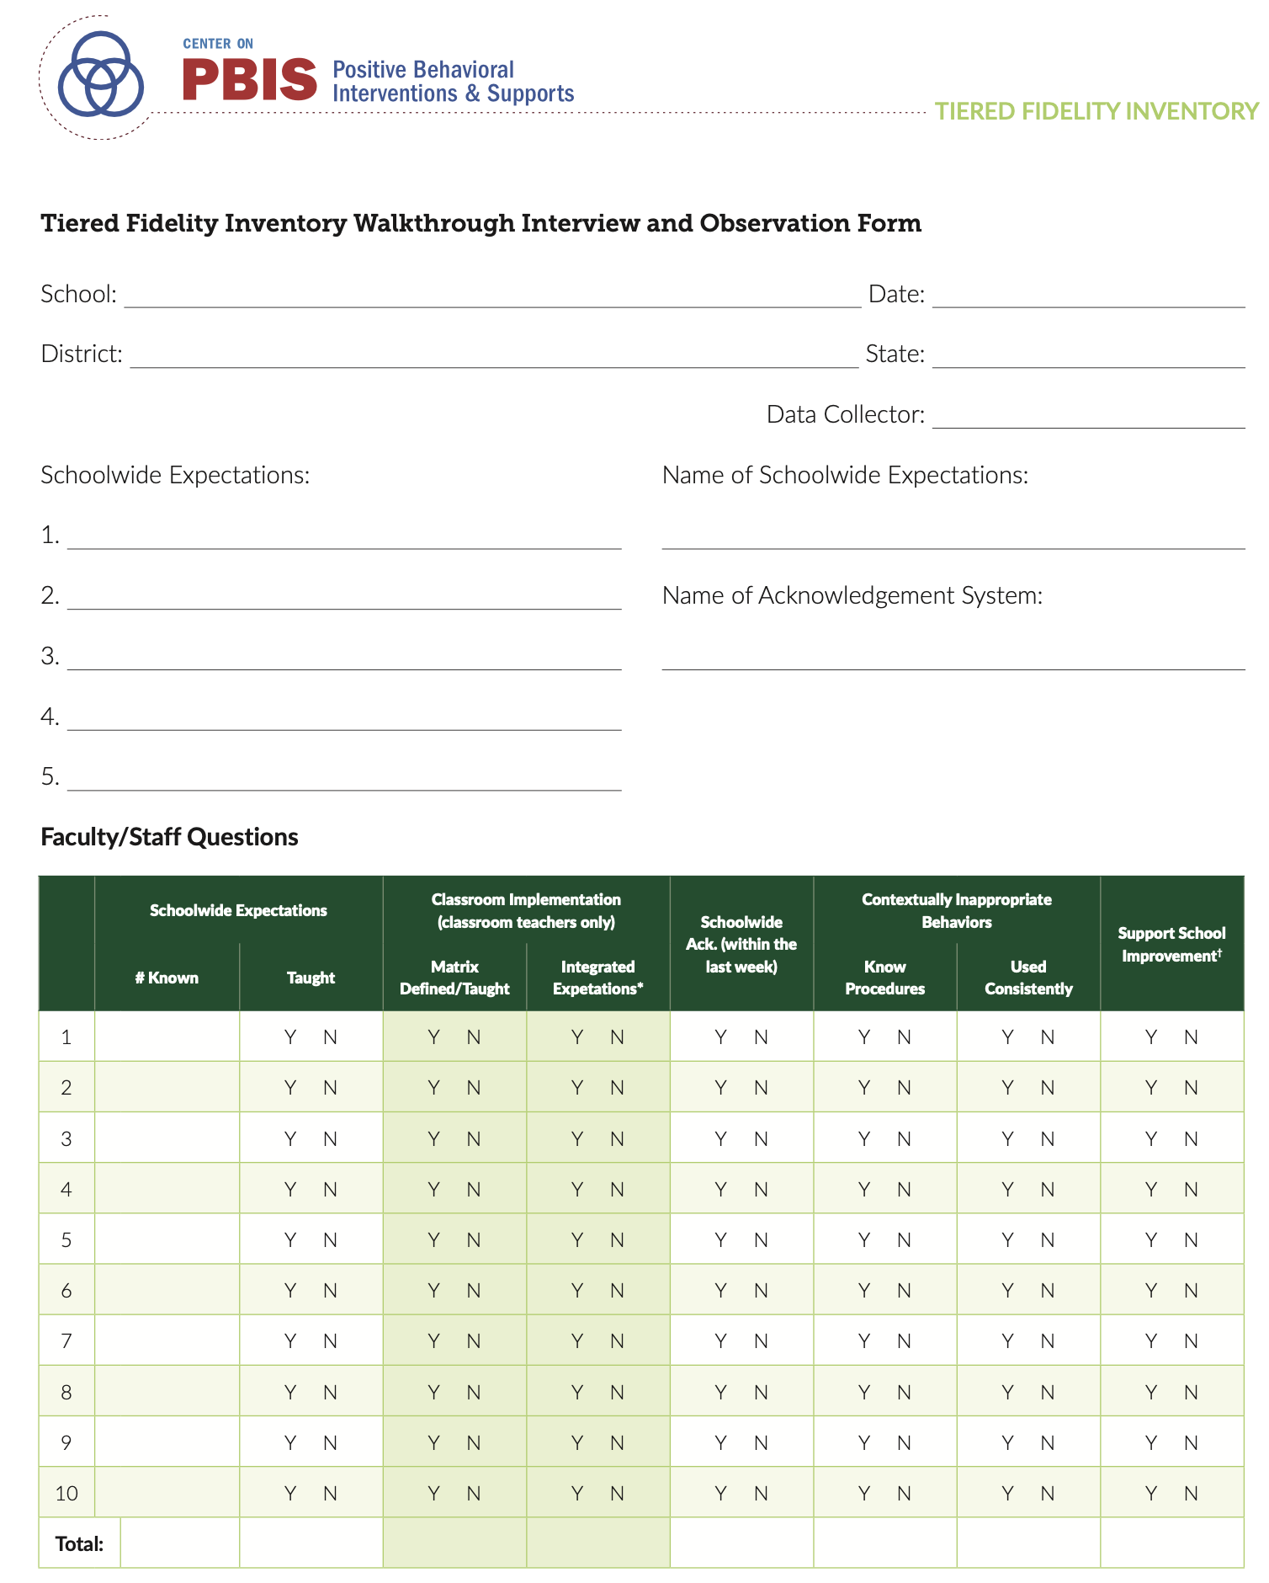
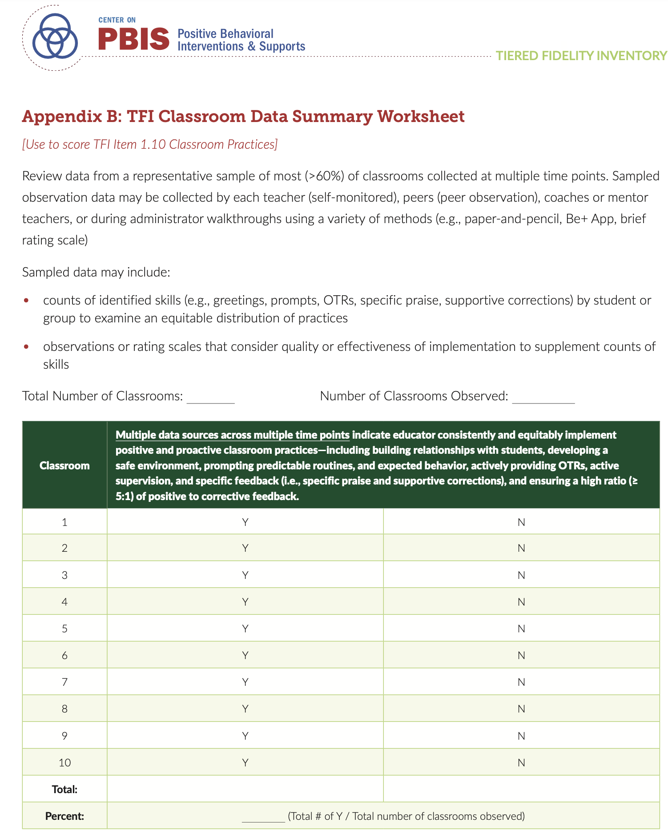
Preparation for Administration
Appendix A:
Walkthrough Interview and Observation Form
Appendix B:
Classroom Data Summary Worksheet
Based on readily available, ongoing classroom data collection.
Worksheet can be completed either prior to or during completion of the TFI
Completed PRIOR to when the team meets to complete the TFI
Notes:
Audio:
Several TFI items require information that must be collected prior to teams completing the TFI Tier 1 Scale.
Two resources, The TFI Walkthrough Tool, used to gather staff and student perceptions, and the Classroom Data Summary Worksheet, based on ongoing classroom data collection, have been specially designed to assist with this data collection. Both of these tools are appendices within the TFI 3.0 manual.

Slide 9
TFI Walkthrough Procedures
Why?
provides a snapshot of schoolwide implementation
informs team scoring of key fidelity items on the TFI rubric
may identify implementation areas for teams to explore more in-depth.
When?
before completing the TFI
takes about 20-30 minutes
Who?
during formal, annual assessment, an individual who is external to the school (e.g., external coach, coordinator) conducts the walkthrough
when used as a progress monitoring tool, an individual from the school team completes it
Relevant TFI Features
1.3 Schoolwide Expectations
1.4 Schoolwide Expectations Taught
1.5 Schoolwide Acknowledgement
1.6 Contextually Inappropriate Behavior Definitions
1.9 Schoolwide Practices used in Classrooms
1.11 Established Priority
Notes:
Audio:
The TFI Walkthrough provides teams with relevant and timely data that offers a snapshot into how staff and students are experiencing implementation in their school. Teams can use this data to inform TFI scoring and action planning.
The TFI Walkthrough should be completed before the team sits down to score the TFI. It takes about 20-30 minutes to complete. When the TFI is being completed as a formal, annual assessment, an individual who is external to the school, such as an external coordinator, district coordinator or school coach from another school within the district, should complete the walkthrough. If the TFI is being completed as a progress monitoring tool, a school team member can complete the walkthrough.
Responses to staff and student questions will be used to determine scores for several TFI items.

Slide 10
TFI Walkthrough Procedures
Interview at least 10% of staff or at least 5 staff members for smaller schools
TFI Item | Question
1.3 | What are the schoolwide expectations or values ?
1.4 | Have you taught the behavioral expectations defined in the schoolwide matrix this year?
1.9 | If staff person is a classroom teacher: Have you also defined and taught these behavioral expectations for each of your classroom routines (Classroom Matrix)? Have you integrated the schoolwide expectations into your academic and social emotional behavioral (SEB) curriculum If yes, can you give an example of one way you have done this?
1.5 | Have you acknowledged students for demonstrating behaviors or skills reflected on the schoolwide matrix within the last week
1.6 | Do you know the schoolwide procedures for handling contextually inappropriate behavior, including what behaviors are office supported vs. teacher/staff supported?
1.7 | Are the established procedures for responding to contextually inappropriate behavior used consistently across the school?
1.11 | Does PBIS implementation support school improvement goals
Notes:
Audio:
The individual conducting the walkthrough should select a random sample of 10% of staff, including non-instructional staff, to ask the interview questions. It should take less than 1 minute to ask questions of each person.

Slide 11
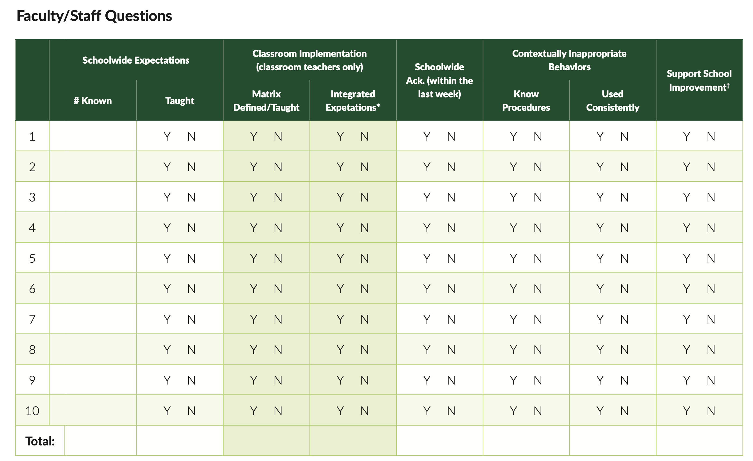
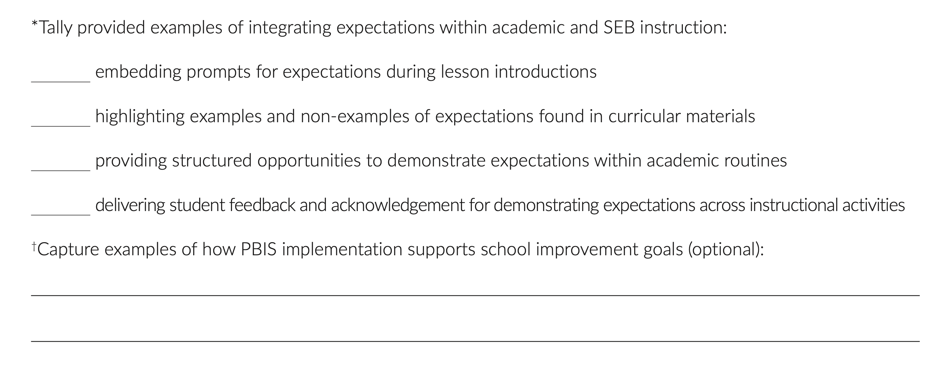
TFI Walkthrough Procedures
Notes:
Audio:
Appendix A provides a table for quick scoring of staff responses.
(click)
as well as a place to capture details about responses about how classroom implementers integrate expectations into their curriculum and how PBIS supports school improvement goals

Slide 12
TFI Walkthrough Procedures
Interview a minimum of 10 students
TFI Item | Question
1.4 | What are the schoolwide expectations or values ?
1.4 | Can you give an example of ________(school expectation) in the _______ (current setting or routine)?
1.5 | Have you been acknowledged (or earned ______) for demonstrating the schoolwide expectations or values in the last 2 weeks?
1.5 | Are you acknowledged or rewarded in ways that you like (elementary) or are meaningful to you (secondary
Notes:
Audio:
The person conducting the walkthrough should also interview a random selection of at least 10 students throughout the school. It is important to gather data from students across grade levels and other demographics.

Slide 13
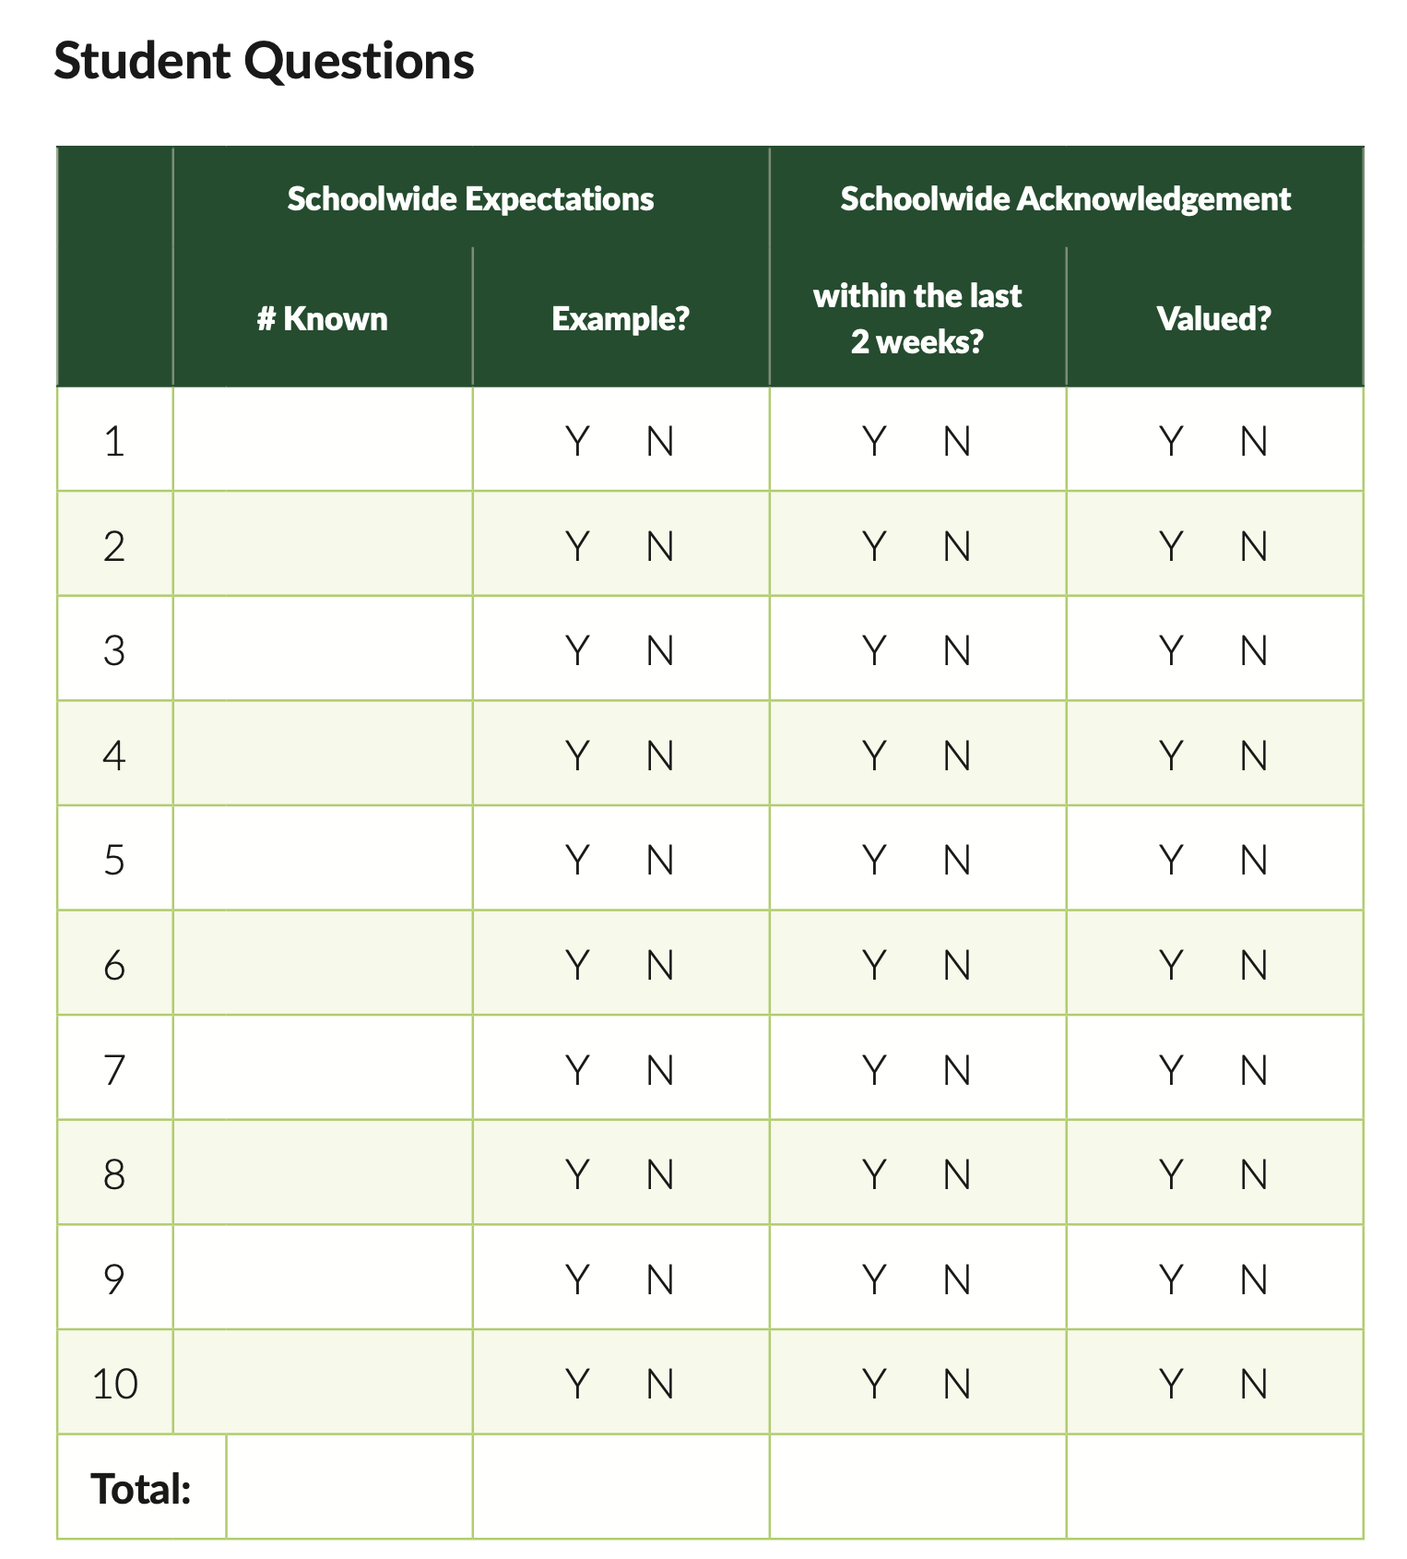
TFI Walkthrough Procedures
Notes:
Audio:
A similar scoring table is provided for student interview questions

Slide 14
Classroom Data Summary Procedures
Review data from a representative sample of most (>60%) of classrooms collected at multiple time points
Data may be collected by
teacher self-monitoring
peer observations
coaches or mentor teachers
administrators
Various methods may be used
paper-and-pencil
Be+ App
brief rating scale
Used to answer Item 1.10 Classroom Procedures
Notes:
Audio:
The classroom data summary worksheet is used to respond to Item 1.10 Classroom Practices. This is a summary of ongoing classroom data collection used as part of data routines. At least 60% of classrooms, representative of diverse settings, should be included in this summary. The team should review multiple data sources across multiple time points that indicate whether or not educators are using positive and proactive classroom practices consistently and equitably. How data is collected will depend upon the current systems set up within the school.

Slide 15
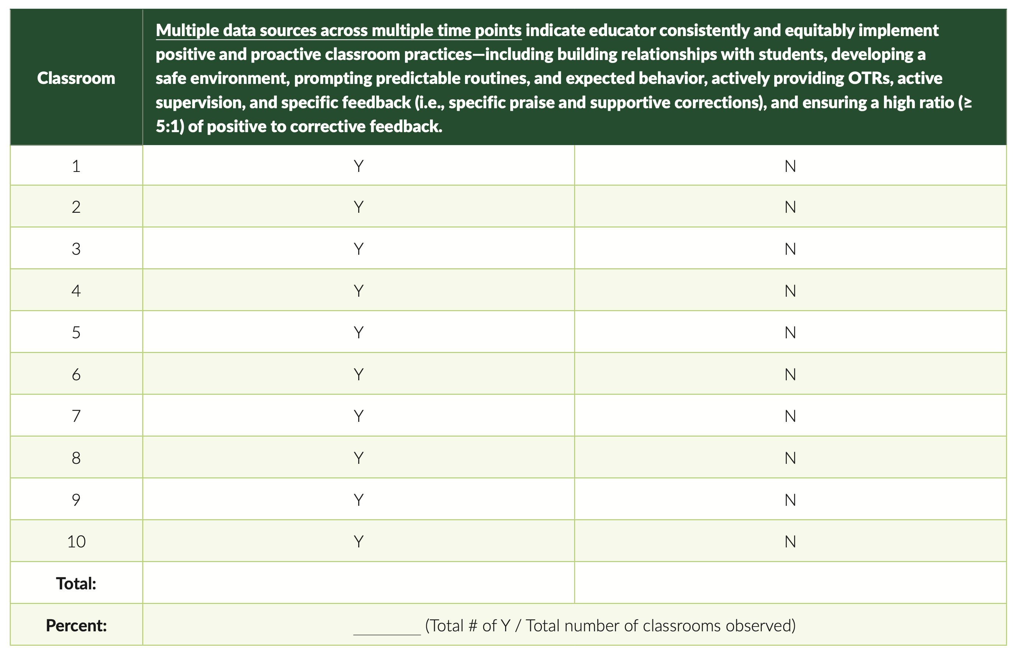
Classroom Data Summary Procedures
counts of identified skills
greetings
prompts,
OTRs
specific praise
supportive corrections
observations or rating scales that consider quality or effectiveness of implementation to supplement counts of skills
Sampled data may include:
Notes:
Audio:
The data reviewed should match the current priorities and in-place data routines of the school. If a school is not routinely collecting classroom data, this can serve as a way to pilot classroom data collection. However, it is important to remember that one short classroom observation likely does not accurately capture implementation of practices. This worksheet provides a snapshot of the broad, continuous implementation efforts.

Slide 16
TFI Item Number and Name
Subscale: Name
Feature Description
Possible Data Sources
Main idea:
An explanation of the main idea for this item
Notes:
Audio:
As teams sit down to complete the TFI, they will read through each item and rate themselves based on identified scoring criteria. Throughout this presentation, each item of the TFI is described in this format: At the top of the slide is the item name and number. The subscale that the item is associated with is in the top row of the chart. Below that is the item description and the possible data sources that can assist in scoring. Included is also a main idea statement that summarizes the main purpose of the item and how it relates to the bigger picture of PBIS implementation.

Slide 17
TFI Item Number and Name
0 | 1 | 2 | 3 | 4
Scoring criteria for a score of 0. | Scoring criteria for a score of 1. | Scoring criteria for a score of 2. | Scoring criteria for a score of 3. | Scoring Criteria for a score of 4.
Reflective questions to focus the conversation: Question Documentation Process
Notes:
Audio:
For each item, there will also be a scoring slide to assist the team in scoring the item. Each of these slides also include reflection questions to help guide your team with building consensus around a score. This most recent version of the TFI has an expanded, 5-point scale rather than the previous version’s 2-point scale.

Slide 18
1.1 Team Composition
Subscale: Teams
Tier 1 leadership team includes the following roles: 1-2 Tier 1 system coordinators (e.g., coaches), a school administrator, a representative group of educators (e.g., grade level or departmental representation, general and special education, certified and non-certified staff), students, family members who do not work for the school district, members from marginalized groups, relevant community partners (e.g., mental health providers), and individuals who actively provide expertise the following areas: applied behavior support mental health and trauma academic instruction coaching equity physical health and wellness (e.g., nurse, health teacher) data systems and information regarding system and student academic and SEB strengths and needs operations of the school across grade levels and programs
Possible Data Sources | School organizational chart Tier 1 team meeting minutes
Main Idea:
Teams need people with multiple skills and perspectives to implement PBIS well.
Back to ALL ITEMS
Notes:
Audio:
The first item is about tier 1 team composition. The item specifically lists the types of roles that are needed to make sure that appropriate personnel, with expertise are included. Family and community members and members from marginalized groups are also essential to the team.

Slide 19
1.1 Team Composition
0 | 1 | 2 |  | 3 | 4
Team does not exist or does not include a coordinator, school administrator, or individuals with applied behavioral expertise. | Team exists, but does not include all identified roles, or participation of these members is below 80%. | Team with all roles exists and is actively engaged with participation of all roles at or above 80%. |  | Team with all roles exists, is actively engaged with participation of all roles at or above 80%, and either a written process is followed for selecting, orienting, recruiting, and retaining team members or Tier 1 leadership team includes members from the group that is most exposed to disparate outcomes in this school (e.g., exclusionary discipline, bullying, mental health referrals) | Team with all roles exists, is actively engaged with participation of all roles at or above 80%, and both a written process is followed for selecting, orienting, recruiting, and retaining team members and Tier 1 leadership team includes members from the group that is most exposed to disparate outcomes in this school
Team Roles Assessment: Tier 1 Coordinator(s) Administrative authority A representative group of educators Student perspective Family member(s) Representation from marginalized groups Community partners |  |  | Additionally, expertise in: Behavior Mental Health Academic Instruction Coaching Equity Physical Health and wellness Data systems and information School operations
Back to ALL ITEMS
Notes:
Audio:
Scoring for this item is based on the representation of roles, consistent participation in meetings, and processes for recruiting, orienting, and retaining team members. The team should include the roles in the checklist. One person may provide more than one role/perspective. For example, someone with behavioral expertise may also provide coaching. A common question is whether the family member and student member needs to attend the team meetings. Student representation can be team members that can bring information on the students’ perspectives to the meeting however the family member needs to be in attendance and the family member needs to be someone who does not work in the school.

Slide 20
1.2 Team Operating Procedures
Subscale: Teams
Tier 1 leadership team has (a) regular meeting format/agenda that prompts the regular review of Tier 1 practices, systems, and data, (b) minutes available to all staff for review, (c) established and regularly used team norms, (d) defined meeting roles (e.g., timekeeper, facilitator, recorder), (e) regular (e.g., quarterly) two-way data sharing and communication with advanced tiers teams to inform decision making, (f) a current action plan, (g) procedure for evaluating fidelity of team operating procedures (e.g., Team Initiated Problem Solving [TIPS] Fidelity Checklist) at least twice annually, and (h) a formal process to monitor the impact of team norms and procedures on ensuring all team members are able to participate as equal partners.
Possible Data Sources | Tier 1 team meeting agendas and minutes Tier 1 meeting roles descriptions Tier 1 action plan Team Initiated Problem Solving (TIPS) fidelity checklist items 1-9
Main Idea:
Specific features are necessary to ensure meetings are effective for action planning and tracking progress.
Back to ALL ITEMS
Notes:
Audio:
This Item focuses on the team operating procedures that will assist the team to run efficient and effective meetings. The main idea is that teams utilize operating procedures that will ensure teams effectively action plan and track progress during their meetings.

Slide 21
1.2 Team Operating Procedures
0 | 1 | 2 | 3 | 4
Team does not meet monthly, use regular meeting format/agenda, minutes, defined roles, or a current action plan. | Team meets at least monthly and has at least three but not all six of the procedures listed a-f. | Team meets at least monthly and has at least four but not all six of the procedures listed a-f. | Team meets at least monthly and has at least five but not all six of the procedures listed a-f, and either g or h. | Team meets at least monthly and has all eight of the procedures listed a-h.
Team Assessment: Regular, monthly meetings Use of a meeting format/agenda to prompt review of essential tier 1 components Meeting minutes are accessible to all staff Establishment and use of team norms Defined meeting roles Data sharing with advanced tiers Action plan current to the school year Plan for evaluating fidelity of team operating procedures Minutes taken during and disseminated after each meeting Plan for monitoring participation of all team members.
Back to ALL ITEMS
Notes:
Audio:
Scoring for this item is based on the number of procedures that are in place. Use the checklist to help determine what is currently in place and specific ways to strengthen team operations.

Slide 22
1.3 Schoolwide Expectations
Subscale: Practices
The school has established a set of five or fewer positively stated schoolwide SEB expectations or values that are (a) aligned to the school vision for climate and culture (item 1.11), (b) posted accessibly (e.g., in at least the two most common home languages, developmentally appropriate) around the school, (c) defined in a schoolwide teaching matrix with specific examples by setting and routine, (d) known by staff, (e) aligned to SEB standards or curriculum.
Possible Data Sources | TFI walkthrough tool SEB standards/ Matrix alignment grid Staff handbook Student handbook
Main idea:
Having school-wide, positively stated social-emotional-behavioral (SEB) expectations promotes a positive and equitable social culture.
Back to ALL ITEMS
Notes:
Audio:
Having social-emotional-behavioral expectations that are positively stated is one of the best ways to establish a positive and equitable school culture. The results of the TFI Walkthrough Tool will assist in assessing staff familiarity with the expectations.

Slide 23
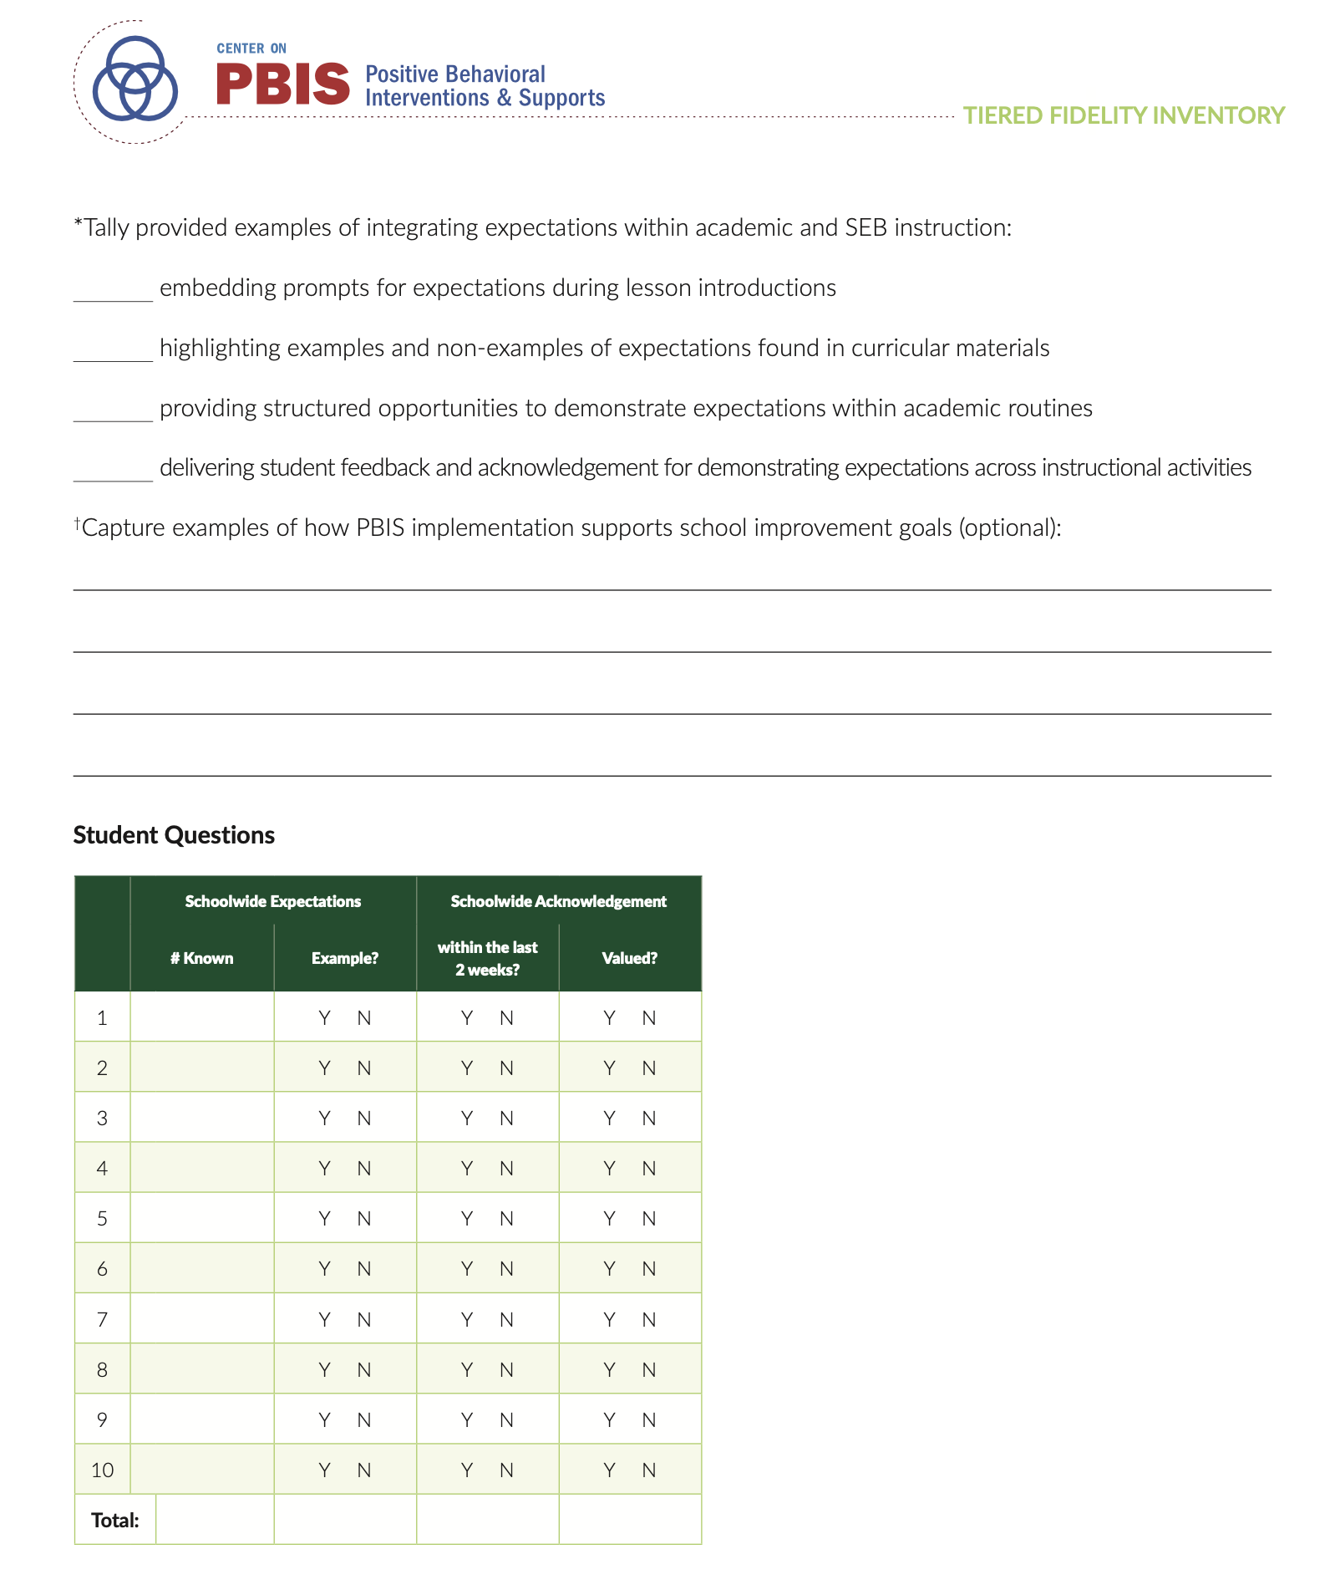
TFI Walkthrough: Appendix A
Back to ALL ITEMS
Notes:
The TFI Walkthrough Tool is in Appendix A of the TFI. This is a tool that is used by a coach/external person to complete prior to the TFI.

Slide 24
1.3 Schoolwide Expectations
0 | 1 | 2 | 3 | 4
Schoolwide expectations have not been identified, are not all positive, or are more than five in number. | Five or fewer positive schoolwide expectations exist but may not be aligned with the school vision, accessibly posted, identified for specific settings and routines (i.e., teaching matrix), or known by staff. | Five or fewer positive schoolwide expectations exist, are aligned with the school vision, accessibly posted, and identified for specific settings and routines (i.e., teaching matrix), and at least 80% of staff can list at least 67% of the expectations. | Five or fewer positive schoolwide expectations exist, are aligned with the school vision, accessibly posted, identified for specific settings and routines (i.e., teaching matrix), and at least 90% of staff can list all of the expectations. | Five or fewer positive schoolwide expectations exist that are aligned with the school vision, accessibly posted, identified for specific settings and routines (i.e., teaching matrix), and at least 90% of staff can list all of the expectations, and SEB curriculum or standards are clearly aligned to the schoolwide expectations and explicit within teaching matrix.
Reflective questions to focus the conversation: Has the team identified five or fewer behavioral expectations? Do they include examples by location/setting? Are they publicly posted throughout the school and in the two most common home languages? Are staff familiar with the expectations? Is the SEB curriculum aligned with the expectations?
Back to ALL ITEMS
Notes:
Audio:
Scoring for this item is based on the degree to which the schoolwide expectations are not only in place, but also accessible, known by staff, and aligned with the SEB curriculum. The reflective questions help determine what is already in place.

Slide 25
1.4 Teaching Expectations
Subscale: Practices
Educators explicitly teach expectations through the established examples and routines reflected in the teaching matrix and integrate active supervision and prompting, reviewing, and reinforcing expectations within existing SEB or academic instruction.
Possible Data Sources | TFI walkthrough tool Lesson plans Professional development calendar
Main Idea:
Teaching expected behaviors is critical in establishing a positive school culture.
Back to ALL ITEMS
Notes:
Audio:
This item builds off the previous item and is focused on the direct instruction of the established schoolwide expectations. It includes the essential actions of active supervision, prompting, reviewing, and reinforcing expectations to provide students with differentiated supports and feedback.

Slide 26
1.4 Teaching Expectations
0 | 1 | 2 | 3 | 4
Schoolwide expectations are not taught. | Schoolwide expectations are taught informally or inconsistently. | A written process for scheduled delivery of lesson plans is used to directly teach, practice, actively supervise, and prompt academic/SEB competencies and routines as defined in the schoolwide teaching matrix across all settings, and at least 80% of students can list at least 100% of the expectations and give an example of at least one expectation within a particular setting or routine. | A written process for scheduled delivery of lesson plans is used to directly teach, practice, actively supervise and prompt, academic/SEB competencies and routines as defined in the schoolwide teaching matrix across all settings, at least 80% of students can list at least all of the expectations and give an example of at least one expectation within a particular setting or routine, and at least 50% of educators can give an example of how schoolwide expectations are monitored, prompted, reviewed, or reinforced within SEB or academic instruction. | A written process for scheduled delivery of lesson plans is used to directly teach, practice, actively supervise and prompt, academic/SEB competencies and routines as defined in the schoolwide teaching matrix across all settings, at least 80% of students can list all of the expectations and give an example of at least one expectation within a particular setting or routine, and at least 80% of educators can give an example of how schoolwide expectations are monitored, prompted, reviewed, or reinforced within SEB or academic instruction.
Reflective questions to focus the conversation: Are regularly scheduled times identified for teaching expectations at least once per school year? Is there a documented teaching schedule? Are the behavioral expectations taught to all students across all school settings (e.g., cafeteria, hallways, classrooms, etc.)? Are students fluent in the schoolwide expectations? Are the adults fluent in the system for teaching, promoting, and reinforcing schoolwide expectations?
Back to ALL ITEMS
Notes:
Audio:
Scoring for this item is based on the strength of the instructional components that support the established schoolwide expectations. Notice that scoring is also based on students’ and educators’ fluency with the schoolwide expectations and the system to promote fluency. Data to score this item can be supported by the TFI walkthrough tool.

Slide 27
1.5 Schoolwide Acknowledgement
Subscale: Practices
Educators consistently and equitably implement a written process for delivering behavior-specific praise that is (a) linked to schoolwide expectations, (b) used across settings, (c) documented (e.g., electronically tracked, count of tokens) and (d) differentiated to meet students’ needs to acknowledge students’ academic and SEB skills in a manner valued by students.
Possible Data Sources | TFI walkthrough tool School handbook or documentation of acknowledgement system Data on staff acknowledgement (e.g., feedback collected via Be+ app, count of positive/praise tickets)
Main idea:
Students will sustain positive behavior only if there are regular strategies for continuous re-teaching and reinforcement of contextually appropriate behavior.
Formal systems prompt teachers/staff to provide positive feedback.
Back to ALL ITEMS
Notes:
Audio:
This item stresses the role of feedback in promoting established behavior expectations. This includes on-going re-teaching and reinforcement within a formal system.

Slide 28
1.5 Schoolwide Acknowledgement
0 | 1 | 2 | 3 | 4
No written process for acknowledging students is used; very few (<20%) educators consistently and equitably acknowledge students, OR very few (<20%) students experience acknowledgement in a manner they value. | A written process for delivering acknowledgement with at least two of the four features a-d is used and few (20-40%) educators consistently and equitably acknowledge students, or few (20-40%) students experience acknowledgement in a manner they value. | A written process for delivering acknowledgement with all four features a-d is used and some (40-60%) educators consistently and equitably acknowledge students, or some (40-60%) students experience acknowledgement in a manner they value. | A written process for delivering acknowledgement with all 4 features a-d is used and most (60-80%) educators consistently and equitably acknowledge students, or most (60-80%) students experience acknowledgement in a manner they value. | A written process for delivering acknowledgement with all 4 features a-d is used and almost all (>80%) educators consistently and equitably acknowledge students, and almost all (>80%) students experience acknowledgement in a manner they value.
Reflective questions to focus the conversation: Are the acknowledgements linked to the school-wide expectations? Are they distributed across all school settings? When interviewed, do 80% or more of staff provide and 80% or more of students receive frequent acknowledgement? Do students value how they are acknowledged?
Back to ALL ITEMS
Notes:
Audio:
Scoring for this item is based on the number of features in place, including adults’ delivery of acknowledgements and students’ receipt of those acknowledgements. The TFI walkthrough tool can be used to provide data to assist with scoring for this item.

Slide 29
1.6 Contextually Inappropriate Behavior Definitions
Subscale: Practices
The school has established, documented, and shared with staff, students and families clear definitions and a continuum of major to minor contextually inappropriate behaviors that interfere with academic and SEB access and success (e.g., T-chart of office-supported versus staff-supported behaviors), including examples and non-examples to clarify situational appropriateness, clear definitions of crisis behaviors, and reviewed to ensure behaviors deemed unacceptable in the school context are grounded in purpose.
Possible Data Sources | TFI walkthrough tool Staff handbook Student handbook School policy Discipline flowchart Cultural Responsiveness Field Guide- Schoolwide expectations and matrix examination activity
Main Idea:
Operational definitions of and consistent processes for responding to contextually inappropriate behavior improves the “predictability” of expectations in the school.
Back to ALL ITEMS
Notes:
Audio:
Developing operational definitions of contextually inappropriate behavior and training staff on the definitions are important in ensuring students experience consistency and predictability throughout the school.

Slide 30
1.6 Contextually Inappropriate Behavior Definitions
0 | 1 | 2 | 3 | 4
Definitions do not exist or are not clearly documented. | Definitions and documentation exist but are not clear or not organized by office vs. staff supported. | Definitions of contextually inappropriate behavior are clear (i.e., include examples and non-examples to clarify situational variability), documented, trained, and shared with families, and 80% of staff agree about what behaviors are office vs. staff supported. | Definitions of contextually inappropriate behavior are clear, documented, trained, and shared with families, 80% of staff agree about what behaviors are office vs. staff supported including either clearly defined crisis behaviors or behaviors determined to be unacceptable in the school setting are grounded in actual purpose (i.e., to keep students safe, to enable learning). | Definitions of contextually inappropriate behavior are clear, documented, trained, and shared with families, 80% of staff agree about what behaviors are office vs. staff supported including clearly defined crisis behaviors, and behaviors determined to be unacceptable in the school setting are grounded in actual purpose (i.e., to keep students safe, to enable learning).
Reflective questions to focus the conversation: Are contextually inappropriate behavior definitions written down and documented? Are crisis behaviors clearly defined? Do the definitions clearly differentiate between staff-managed and office-managed behaviors? Are all staff and faculty members trained and fluent on the definitions? Are the definitions shared with families?
Back to ALL ITEMS
Notes:
Audio:
Scoring for this item is based on the components identified in the reflective questions. Each score category adds another element related to strengthening the definition and universality of problematic behaviors in the school setting.

Slide 31
1.7 Responses to Contextually Inappropriate Behavior
Subscale: Practices
Educators consistently and equitably implement a continuum of functionally-relevant, instructional, and restorative responses to contextually inappropriate behavior (e.g., response flowchart) that (a) reminds or (re)teaches expectations, as appropriate, to promote student SEB growth and wellness; (b) prioritizes student access to classroom instruction; and (c) emphasizes de-escalation and safety planning (e.g., a standard protocol for temporarily supporting students in crisis until more intensive supports can be implemented), when necessary, to reduce the need for crisis responses.
Possible Data Sources | TFI walkthrough interview Discipline policy Student handbook Code of conduct
Main idea:
The adults’ response to contextually inappropriate behaviors help guide future patterns of behavior.
Back to ALL ITEMS
Notes:
Audio:
In contrast to the previous item, 1.7 is focused on the adults’ response when contextually inappropriate behaviors are displayed. While preventative and positive approaches to discipline are the most effective in developing a positive school climate, adults need to respond to contextually inappropriate behavior with consistent, instructional, and functionally-based responses to help shape future behaviors.

Slide 32
1.7 Responses to Contextually Inappropriate Behavior
0 | 1 | 2 | 3 | 4
Continuum includes only reactive and punitive consequences. | Continuum includes and emphasizes functionally-relevant, instructional, and restorative responses. | Continuum includes and emphasizes functionally-relevant, instructional, and restorative responses, and at least 70% of staff members report consistent and equitable use, and policies restrict the use of out-of-school suspensions only to behaviors with safety concerns. | Continuum includes and emphasizes functionally-relevant, instructional, and restorative responses, at least 70% of staff members report consistent and equitable use, policies restrict the use of out-of-school suspensions only to behaviors with safety concerns, and a standard protocol for supporting students in crisis until more intensive supports can be put in place exists with all staff trained and supported to deescalate crisis behaviors effectively. | Continuum includes and emphasizes functionally-relevant, instructional, and restorative responses, at least 70% of staff members report consistent and equitable use, policies restrict the use of out-of-school suspensions only to behaviors with safety concerns, a standard protocol for supporting students in crisis until more intensive supports can be put in place exists with all staff trained and supported to deescalate crisis behaviors effectively, and restrictive procedures such as restraint are eliminated or if used/allowed, actively monitored for reduction.
Reflective questions to focus the conversation: Are disciplinary practices proactive and preventative? Do responses help keep children in school and in the classroom, or is there a reliance on exclusionary practices? Are responses consistent across staff members? Is there clear documentation of discipline procedures? Do administrators report consistent use of proactive, preventative approaches? Is there a plan for supporting students when they are in crisis?
Back to ALL ITEMS
Notes:
Audio:
Scoring for this item is based on the components listed in the reflective questions. Here again, elements of the TFI walkthrough tool can support scoring. Notice the emphasis on the equitable use of effective and consistent responses.

Slide 33
1.8 Crisis & Emergency Response Plan Linked to Schoolwide Supports
Subscale: Practices
Schoolwide expectations are explicitly defined for crisis response routines within the schoolwide matrix and the documented crisis and emergency response plan (e.g., evacuation, lockdown or shelter in place) includes plans to prompt and reinforce expectations during crisis drill activities and strategies to support student and staff wellness before, during, and after crisis drill or response.
Possible Data Sources | Crisis response plan documentation Staff and student wellness plans Team action plan
Main idea:
Staff and student wellbeing can be supported during crisis by proactively establishing, explicitly teaching, and reinforcing clear expectations and supports.
Back to ALL ITEMS
Notes:
Audio:
This item extends the schoolwide expectations to emergency or crisis response routines. Expectations for these routines need to be proactively established, taught, prompted, and reinforced as explicitly as they are across other schoolwide routines.

Slide 34
1.8 Crisis & Emergency Response Plan Linked to Schoolwide Supports
0 | 1 | 2 | 3 | 4
No crisis response plan exists or no evidence of alignment to school-wide expectations evident. | A crisis response plan is clearly documented, and procedures are informally linked to schoolwide expectations. | Schoolwide expectations are explicitly defined for crisis response routines within the school-wide matrix, expectations are actively taught, prompted, and reinforced during crisis drill activities. | Schoolwide expectations are explicitly defined for crisis response routines within the schoolwide matrix, expectations are actively taught, prompted, and reinforced during crisis drill activities, and crisis response plan includes strategies to promote student and staff wellness before, during, and after crisis drill or response. | Schoolwide expectations are explicitly defined for crisis response routines within the schoolwide matrix, expectations are actively taught, prompted, and reinforced during crisis drill activities, and crisis response plan includes differentiated strategies to promote student and staff wellness before, during, and after crisis drill or response.
Reflective questions to focus the conversation: Are the expectations and procedures for crisis or emergency routines identified within the schoolwide matrix? Are those expectations explicitly taught and reinforced? Are there supports in place for student and staff wellness?
Back to ALL ITEMS
Notes:
Audio:
Scoring for this item is based on the components listed in the reflection questions. Notice that this items includes supporting student and staff wellness before, during, and after crisis drills or response.

Slide 35
1.9 Schoolwide Practices used in Classrooms
Subscale: Practices
Educators implement foundational Tier 1 practices (explicitly teach, prompt, and review schoolwide expectations as described in 1.4; implement schoolwide acknowledgements as described in 1.5; and respond to challenging behavior as described in 1.7) across all classroom locations and routines and integrate these supports within all academic and SEB instruction in a culturally responsive manner.
Possible Data Sources | TFI walkthrough tool
Main idea:
PBIS expectations need to be integrated into classroom systems. This improves consistency in behavior support practices across all adults.
Back to ALL ITEMS
Notes:
Audio:
Tier I practices that are implemented within the school-wide systems need to be applied in the classroom. This item relies on criteria from three previously-scored items and their use in classroom settings: explicitly teaching and reinforcing school-wide expectations, implementing schoolwide acknowledgements, and responding to challenging behaviors.

Slide 36
1.9 Schoolwide Practices used in Classrooms
0 | 1 | 2 | 3 | 4
No or very few (<20%) educators consistently implement all foundational Tier 1 practices (schoolwide expectations, acknowledgements, and responses) in a culturally-responsive manner in the classroom. | Few (20-39%) educators consistently implement all foundational Tier 1 practices (schoolwide expectations, acknowledgements, and responses) in a culturally-responsive manner in the classroom. | Some (40-60%) educators are consistently implementing all foundational Tier 1 practices (schoolwide expectations, acknowledgements, and responses) in a culturally-responsive manner in the classroom. | Most (61-80%) educators are consistently implementing all foundational Tier 1 practices (schoolwide expectations, acknowledgements, and responses) in a culturally-responsive manner in the classroom and some (40%-60%) educators report integrating these supports within academic and SEB instruction. | Almost all (>80%) educators are consistently implementing all foundational Tier 1 practices (schoolwide expectations, acknowledgements, and responses) in a culturally-responsive manner in the classroom and most (>61%) educators report integrating these supports within academic and SEB instruction.
Reflective questions to focus the conversation: Are educators establishing expectations for their particular setting? Do they consistently use acknowledgements and effective responses to behavior? Are the supports integrated within academic and SEB instruction?
Back to ALL ITEMS
Notes:
Audio:
Scoring for this item is based on the percentage of educators in the building who are consistently implementing foundational Tier 1 practices in their teaching settings. Items in the TFI Walkthrough tool can provide data to support scoring this item.

Slide 37
1.10 Classroom Practices
Subscale: Practices
Educators consistently and equitably implement positive and proactive classroom practices--including building relationships with students; developing a safe environment; prompting predictable routines and expected behavior; actively providing OTRs, active supervision, and specific feedback (i.e., specific praise and supportive corrections); and ensuring a high ratio (≥ 5:1) of positive to corrective feedback.
Possible Data Sources | TFI Classroom Data Summary Worksheet
Main idea:
Tier 1 implementation includes the equitable use of evidence-based classroom practices that are known to support SEB and academic growth.
Back to ALL ITEMS
Notes:
Audio:
Similar to the previous item, this one is also focused on the application of foundational Tier 1 practices in the classroom setting. Here, the emphasis is on the educator’s use of positive and proactive practices. The item specifies which practices should be in place.

Slide 38
Appendix B:
TFI Classroom Data Summary Worksheet
Back to ALL ITEMS
Notes:
Audio:
The TFI Classroom Data Summary Worksheet (Appendix B) should be used to support scoring this item.

Slide 39
1.10 Classroom Practices
0 | 1 | 2 | 3 | 4
No or very few (<20%) educators consistently and equitably implement positive and proactive practices OR we do not measure this. | Few (20-39%) educators consistently and equitably implement positive and proactive practices. | Some (40-60%) educators consistently and equitably implement positive and proactive practices. | Most (61-80%) educators consistently and equitably implement positive and proactive practices. | Almost all (>80%) educators consistently and equitably implement positive and proactive practices.
Reflective questions to focus the conversation: Are educators consistently using proactive and preventative practices in their classrooms? Is there a system in place to routinely measure this?
Back to ALL ITEMS
Notes:
Audio:
Scoring for this item is based on the percentage of educators that consistently use the identified practices.

Slide 40
1.11 Established Priority
Subscale: Systems
The school has a clear purpose statement and established priority for developing and implementing SEB support within a PBIS/MTSS framework aligned to key school and district initiatives and strategic plans and clearly communicated to all educators.
Possible Data Sources | TFI walkthrough tool Working smarter matrix School improvement plans School (student/parent) handbook School website
Main idea:
Tier 1 efforts must be prioritized and communicated at the school and district level to promote strong implementation and sustainability.
.
Back to ALL ITEMS
Notes:
Audio:
This item stresses the commitment of the school and district to the implementation of SEB supports within a multi-tiered framework. This leads to high fidelity of implementation and long-term sustainability.

Slide 41
1.11 Established Priority
0 | 1 | 2 | 3 | 4
SEB support within a PBIS/MTSS framework is not a documented school priority. | Priority of SEB support within a PBIS/MTSS framework is informally documented (e.g., meeting minutes, administrator statement). | Priority of SEB support within a PBIS/MTSS framework is clearly documented as one of the top 3 school improvement goals within school improvement plans. | Priority of SEB support within a PBIS/MTSS framework is clearly documented as one of the top 3 school improvement goals within school improvement plans, and leadership team alignment with related initiatives has been assessed (e.g., working smarter matrix). | Priority of SEB support within a PBIS/MTSS framework is clearly documented as one of the top 3 school improvement goals within school improvement plans, leadership team alignment with related initiatives has been assessed (e.g., working smarter matrix), and at least 80% of staff can articulate how implementation supports school improvement goals.
Reflective questions to focus the conversation: What are the school’s top priorities and current goals? Are related initiatives aligned in their mission? How familiar are staff with the goals and initiatives that are in place?
Back to ALL ITEMS
Notes:
Audio:
Scoring for this item is based on the emphasis and visibility that SEB support has within the school’s improvement plans. Additionally, the degree to which there is alignment among school initiatives and staff fluency with that alignment is considered.

Slide 42
1.12 Schoolwide Professional Development & Coaching
Subscale: Systems
Tier 1 leadership team develops, documents, and implements a comprehensive, data-informed, and differentiated professional development system (PBIS/MTSS for staff), supported by adequate FTE and aligned to other relevant school initiatives, that includes initial and ongoing training, coaching, and supportive performance feedback to all school or community employed faculty/staff on foundational knowledge and Tier 1 practices (items 1.3-1.9).
Possible Data Sources | Professional development (PD) calendar Coaching logs Staff handbook
Main idea:
Effective Tier 1 implementation will require a professional development approach that is consistent, differentiated, and responsive.
Back to ALL ITEMS
Notes:
Audio:
This item highlights the importance of initial and on-going professional development in order to develop and implement Tier 1 practices and systems with a high degree of fidelity. Notice that a continuum of supports, including supportive feedback, is necessary to support adults as they continuously improve their implementation.

Slide 43
1.12 Schoolwide Professional Development & Coaching
0 | 1 | 2 | 3 | 4
Process for training, coaching, and providing feedback is informal (i.e., does not include all staff or all schoolwide Tier 1 practices, is not written, and/or is not part of PD calendar). | A written process for training, coaching, and providing feedback exists and includes all staff and all schoolwide Tier 1 practices. | A written process for training, coaching, and providing feedback includes all staff and all schoolwide Tier 1 practices and is used as part of continuous PD cycle, (i.e., is part of PD calendar). | A written process for training, coaching, and providing feedback includes all staff and all schoolwide Tier 1 practices, is used as part of continuous PD cycle, and additional supports are differentiated based on data-informed need, or PD is aligned with other school initiatives and supports. | A written process for training, coaching, and providing feedback includes all staff and all schoolwide Tier 1 practices, is used as part of continuous PD cycle, additional supports are differentiated based on data-informed need, and PD is aligned with other school initiatives and supports.
Reflective questions to focus the conversation: What training and professional development opportunities in Tier 1 practices exist for all staff? Are these opportunities differentiated for staff who require more support? Do staff have access to supportive feedback to strengthen their implementation of schoolwide Tier 1 practices?
Back to ALL ITEMS
Notes:
Audio:
Scoring for this item is based on the criteria in the reflective questions. Notice the shared emphasis on both initial and on-going training that is responsive to need. Here, the content focus is school-wide, tier 1 efforts.

Slide 44
1.13 Classroom Professional Development & Coaching
Subscale: Systems
Tier 1 leadership team develops, documents, and implements a comprehensive, data-driven, and differentiated professional development system (PBIS/MTSS for staff), supported by adequate FTE and aligned to other relevant school initiatives, that includes initial and ongoing training, coaching, and supportive performance feedback to support educators’ implementation of positive and proactive classroom practices (described in item 1.10).
Possible Data Sources | Professional development calendar Coaching logs Staff handbook
Main idea:
Differentiated and responsive professional learning is necessary to support the implementation of effective Tier 1 classroom practices.
Back to ALL ITEMS
Notes:
Audio:
Similar to the previous item, this one highlights the importance of differentiated and responsive professional learning opportunities to support high quality implementation. In contrast, this item is focused on PD that aims to increase educator’s use of the effective SEB support practices in the classroom as described in item 1.10.

Slide 45
1.13 Classroom Professional Development & Coaching
0 | 1 | 2 | 3 | 4
Process for training, coaching, and providing feedback is informal (i.e., does not include all staff or all classroom Tier 1 practices, is not written, and/or is not part of PD calendar). | A written process for training, coaching, and providing feedback exists and includes all staff and all classroom Tier 1 practices. | A written process for training, coaching, and providing feedback includes all staff and all classroom Tier 1 practices and is used as part of continuous PD cycle, (i.e., is part of PD calendar). | A written process for training, coaching, and providing feedback includes all staff and all classroom Tier 1 practices, is used as part of continuous PD cycle, and additional supports are differentiated based on data-informed need, or PD is aligned with other school initiatives and supports. | A written process for training, coaching, and providing feedback includes all staff and all classroom Tier 1 practices, is used as part of continuous PD cycle, additional supports are differentiated based on data-informed need, and PD is aligned with other school initiatives and supports.
Reflective questions to focus the conversation: What training and professional development opportunities in classroom Tier 1 practices exist for educators? Does the content include the specific classroom practices from item 1.10? Are these opportunities differentiated for staff who require more support? Do staff have access to supportive feedback to strengthen their implementation of evidence-based classroom practices?
Back to ALL ITEMS
Notes:
Audio:
Scoring for this item is based on the criteria in the reflective questions. Here again, notice the shared emphasis on both initial and on-going training that is responsive to need. Here, the content focus is the use of classroom practices including relationship building, developing a safe environment, promoting routines and behavior, providing opportunities to respond, use of active supervision, and a high ratio of positive to corrective feedback.

Slide 46
1.14 Faculty & Staff Engagement
Subscale: Systems
Tier 1 leadership teams purposefully and regularly engage all faculty and staff in co-designing and actively revising the content and the implementation of foundational Tier 1 practices (items 1.3-1.10) and systems (items 1.12-1.13) based on the regular review of schoolwide and community data.
Possible Data Sources | PBIS Self-assessment Survey Feedback and Input Survey (FIS) Informal Surveys Staff meeting minutes Team meeting minutes Social validity surveys Staff handbook
Main idea:
Schools need active engagement of faculty and staff to effectively implement and sustain implementation.
Back to ALL ITEMS
Notes:
Audio:
This item emphasizes the importance of staff participation and voice in the development of foundational Tier 1 elements. This includes the practices detailed in TFI items 1.2 through 1.10 and the systems described in TFI items 1.12 and 1.13.

Slide 47
1.14 Faculty & Staff Engagement
0 | 1 | 2 | 3 | 4
No documentation or no opportunities exist for engaging faculty and staff on examining data or developing/revising foundational Tier 1 practices. | Faculty and staff are engaged in providing input on foundational Tier 1 practices based on a review of school and community data, within the past 12 months. | Faculty and staff are actively engaged in the selection and interpretation of school and community data and provide input on the development or implementation of foundational Tier 1 practices within the past 12 months. | Faculty and staff are actively engaged in the selection and interpretation of school and community data, and, and provide input on the development or implementation of foundational Tier 1 practices, at least twice per year. | Faculty and staff are actively engaged in the selection and interpretation of school and community data, provide input on the development or implementation of foundational Tier 1 practices at least twice per year, and if data indicate a problem, an action plan is developed to enhance or modify foundational Tier 1 practices.
Reflective questions to focus the conversation: Do all faculty and staff have the opportunity to co-develop or provide input on Tier 1 practices and systems? Does this opportunity include interacting with relevant data? How often are these opportunities provided? Is communication bi-directional? Is there a current action plan that incorporates feedback from faculty and staff?
Back to ALL ITEMS
Notes:
Audio:
Scoring for this item is based on the criteria outlined in the self-reflection questions. Teams score higher on this item when faculty and staff are frequently engaged in most implementation activities.

Slide 48
1.15 Student Engagement
Subscale: Systems
Tier 1 leadership teams purposefully and regularly engage students that are representative of (a) the schools’ demographics and (b) any marginalized groups in co-designing and actively revising the content and the implementation of foundational Tier 1 practices (items 1.3-1.10) based on the regular review of schoolwide and community data.
Possible Data Sources | Feedback and Input Survey (FIS) Social validity surveys
Main idea:
Implementation will be more effective and culturally responsive with active engagement from students.
Back to ALL ITEMS
Notes:
Audio:
This item is similar to the preceeding faculty and staff engagement item, but with an emphasis on student involvement.

Slide 49
1.15 Student Engagement
0 | 1 | 2 | 3 | 4
No documentation or no opportunities exist to engage students in examining data or developing/revising foundational Tier 1 practices. | Some students are engaged in providing input on foundational Tier 1 practices based on a review of school and community data, within the past 12 months. | A representative group of students is actively engaged in the selection and interpretation of school and community data and provide input on the development or implementation of foundational Tier 1 practices within the past 12 months. | A representative group of students is actively engaged in the selection and interpretation of school and community data, and provide input on the development or implementation of foundational Tier 1 practices at least twice per year. | A representative group of students is actively engaged in the selection and interpretation of school and community data, provide input on the development or implementation of foundational Tier 1 practices at least twice per year, and if data indicate a problem, an action plan is developed to enhance or modify foundational Tier 1 practices.
Reflective questions to focus the conversation: Do students have the opportunity to co-develop or provide input on Tier 1 practices? Are the students representative of the larger student body? Does this opportunity include interacting with data? How often are these opportunities provided? Is communication bi-directional? Is there a current action plan that incorporates feedback from students?
Back to ALL ITEMS
Notes:
Audio:
Similar to the previous faculty and staff item, scoring for this item is based on the criteria outlined in the self-reflection questions. Teams score higher on this item when students are frequently engaged in more implementation activities.

Slide 50
1.16 Family & Community Engagement
Subscale: Systems
Tier 1 leadership teams purposefully and regularly engage families and community members that are representative of (a) the schools’ demographics and (b) any marginalized groups in co-designing and actively revising the content and the implementation of foundational Tier 1 practices (items 1.3-1.10) based on the regular review of schoolwide and community data.
Possible Data Sources | Voting results from parent/family meeting Feedback and Input Survey (FIS) Team meeting minutes
Main idea:
Implementation will be more effective and culturally responsive with active engagement from family and community members.
Back to ALL ITEMS
Notes:
Audio:
The third engagement item is centered on families and the community. Like the student engagement criteria, there is an emphasis on inclusion of families and community members that are representative of the school population. Notice that the item emphasizes engagement actions that are initiated by school-based personnel.

Slide 51
1.16 Family & Community Engagement
0 | 1 | 2 | 3 | 4
No documentation or no opportunities exist to engage families and community members in examining data or developing/revising foundational Tier 1 practices. | Some families and community members are engaged in providing input on foundational Tier 1 practices based on a review of school and community data, within the past 12 months. | A representative group(s) of families and community members is actively engaged in the selection and interpretation of school and community data and provide input on the development or implementation of foundational Tier 1 practices, within the past 12 months. | A representative group(s) of families and community members are actively engaged in the selection and interpretation of school and community data, and provide input on the development or implementation of foundational Tier 1 practices, at least twice per year. | A representative group(s) of families and community members are actively engaged in the selection and interpretation of school and community data, provide input on the development or implementation of foundational Tier 1 practices at least twice per year, and if data indicate a problem, an action plan is developed to enhance or modify foundational Tier 1 practices.
Reflective questions to focus the conversation: Do families and community members have the opportunity to co-develop or provide input on Tier 1 practices? Is there representation of the larger school community? Does this opportunity include interacting with data? How often are these opportunities provided? Is communication bi-directional? Is there a current action plan that incorporates feedback from these participants?
Back to ALL ITEMS
Notes:
Audio:
Here again, scoring for this item is based on the criteria outlined in the self-reflection questions. Teams score higher on this item when families and community members are engaged in often and across implementation activities.

Slide 52
1.17 Decision Making with Behavior Data
Subscale: Data
Tier 1 leadership team has access to behavior data (e.g., discipline referrals, removal from assigned instructional environment, suspensions, expulsions) that includes (a) all information relevant for decision making (e.g., behavior, date/time, location, student), (b) perceived function, and (c) disciplinary actions organized by the behavior type, frequency of events over time (per day per month), location, time of day, consequence, and by individual student, and uses discipline data at least monthly to develop and regularly re-evaluate a profile of overall strengths and needs that inform the development and delivery of equitable Tier 1 foundational and classroom practices (Items 1.3-1.10).
Possible Data Sources | Data reports Team meeting minutes and action plans
Main idea:
Teams need the right information in the right format and at the right time to make effective decisions.
Back to ALL ITEMS
Notes:
Audio:
This item is focused on teams having access to data to support purposeful decision making and using that data to inform Tier 1 actions. The characteristics of the data detailed in this item can help teams develop and strengthen their data collection methods.

Slide 53
1.17 Decision Making with Behavior Data
0 | 1 | 2 | 3 | 4
Behavior data sources cannot be accessed by leadership team and/or are not used for data-informed actions | Behavior data sources exist and are accessible and team reviews and uses discipline data for data-informed actions, but less than monthly. | Behavior data sources exist, are accessible, the team reports data accurately reflect behavior in the building and data can be aggregated and disaggregated (e.g., race/ethnicity, IEP/504, language status, gender) to identify both strengths and concerns. | Behavior data sources exist, are accessible, are shared with staff at least monthly, the team reports data accurately reflect behavior in the building, data can be aggregated and disaggregated (e.g., race/ethnicity, IEP/504, language status, gender) to identify both strengths and concerns, and team reviews and uses discipline data for data-informed actions at least monthly. | Behavior data sources exist, are accessible, are shared with staff at least monthly, the team reports data accurately reflect behavior in the building, data can be aggregated and disaggregated (e.g., race/ethnicity, IEP/504, language status, gender) to identify both strengths and concerns, team reviews and uses discipline data for data-informed actions at least monthly including monitoring for equitable implementation and outcomes. If data indicate a problem, an action plan is developed to enhance or modify foundational Tier 1 practices.
Reflective questions to focus the conversation: Is there a centralized data system to collect and organize behavioral data? Does the system allow for data to be disaggregated by student group? How frequently is the data reviewed and used? Is implementation and outcomes monitored for equity?
Back to ALL ITEMS
Notes:
Audio:
Scoring for this item is based on the criteria listed in the reflective questions. Teams who are developing or strengthening their data collection system may benefit from using characteristics within this item. Particularly, the ability to disaggregate behavior, implementation, and outcome data by subgroup.

Slide 54
1.18 Using School & Community Data to Inform Tier 1
Subscale: Data
Tier 1 leadership team has regular access to and uses a variety of additional schoolwide (e.g., school climate surveys, attendance, nurse or counselor visit logs, universal screening) and community data sources (e.g., community resource profiles, basic needs [e.g., food and housing], health care access, community events), to develop and regularly re-evaluate a profile of overall strengths and needs that informs the development and delivery of equitable Tier 1 foundational and classroom practices (Items 1.4-1.10).
Possible Data Sources | Data reports Team meeting minutes Action plan
Main idea:
When teams have access to multiple sources of reliable data, they are better able to make decisions that will effectively enhance or modify Tier I systems.
Back to ALL ITEMS
Notes:
Audio:
Similar to the previous item, this one focuses on the use of data to inform Tier 1 decision making. In contrast, this item highlights the value of data outside of what is collected to monitor behavior and can include measures related to climate, needs assessment, or nurse and counselor visits.

Slide 55
1.18 Using School & Community Data to Inform Tier 1
0 | 1 | 2 | 3 | 4
School and community data sources do not exist or cannot be accessed and are not used to develop and re-evaluate a profile of overall strengths and needs. | School or community data sources exist and can be accessed and at least 1 school or community data source is used to develop and re-evaluate a profile of overall strengths and needs. | Multiple school and community data sources exist and can be accessed and can be aggregated and disaggregated (e.g., race/ethnicity, IEP/504, language status, gender) to identify both strengths and concerns. | Multiple school and community data sources exist, can be accessed, can be aggregated and disaggregated (e.g., race/ethnicity, IEP/504, language status, gender) to identify both strengths and concerns, and multiple school and community data sources are used to develop and re-evaluate a profile of overall strengths and needs at least annually. If data indicate a problem, an action plan is developed to enhance or modify foundational Tier 1 practices. | Multiple school and community data sources exist, can be accessed, can be aggregated and disaggregated (e.g., race/ethnicity, IEP/504, language status, gender) to identify both strengths and concerns, and multiple school and community data sources are used to develop and re-evaluate a profile of overall strengths and needs, at least quarterly. If data indicate a problem, an action plan is developed to enhance or modify foundational Tier 1 practices.
Reflective questions to focus the conversation: Is the team collecting and reviewing relevant school data beyond behavior incidents? Does the team utilize community data to inform Tier 1 support needs? Does the team use school and community data to identify problems and related action steps?
Back to ALL ITEMS
Notes:
Audio:
Scoring for this item is based on the criteria listed in the reflective questions. When teams are able to access a wide range of information, they are better able to enhance their Tier 1 systems.

Slide 56
1.19 Decision Making with Fidelity Data
Subscale: Data
Tier 1 leadership team reviews and uses schoolwide (e.g., TFI, BoQ, TIC, SAS, SET) and other fidelity data (e.g., classroom implementation, Tier 1 SEB curriculum, staff wellness systems) at least annually
Possible Data Sources | Data reports Team meeting minutes and action plans Action plan
Main idea:
Measuring fidelity is essential for maintaining high implementation of PBIS.
Back to ALL ITEMS
Notes:
Audio:
This item emphasizes the importance for teams to collect and use data related to the fidelity of implementation, or the degree to which essential features of PBIS are in place. Any Tier I fidelity measure is acceptable. Completing this Tiered Fidelity Inventory is one way to meet this criteria. Notice that the item requires both a schoolwide fidelity measure and another source.

Slide 57
1.19 Decision Making with Fidelity Data
0 | 1 | 2 | 3 | 4
Tier 1 fidelity data are collected informally and/or less than annually. | Tier 1 fidelity data are collected and used for decision making annually. | Multiple Tier 1 fidelity assessments are collected and used for decision making annually. | Multiple Tier 1 fidelity assessments are conducted, including at least one classroom fidelity measure, and used for decision making more than once each year. | Multiple Tier 1 fidelity assessments are conducted and used for decision making at least three times in the past year, including fidelity assessments in at least 50% of classrooms.
Reflective questions to focus the conversation: Is the team assessing fidelity of implementation for schoolwide Tier I? Is the assessment completed at least annually? Is the team assessing classroom implementation? Is the data used for decision making at least annually?
Back to ALL ITEMS
Notes:
Audio:
Scoring for this item is based on the use of multiple fidelity measures, and the frequency of use. Teams can use the reflective questions to drive conversations to assist with scoring this item.

Slide 58
1.20 Evaluation Plan
Subscale: Data
Tier 1 leadership team establishes a plan and then documents the fidelity and effectiveness of equitable Tier 1 practices at least annually (including year-by-year comparisons) that are (a) integrated with other data to inform overall school improvement efforts and (b) shared with partners (staff, families, community, district) in a usable format
Possible Data Sources | Action plan School evaluation reports District evaluation reports School newspapers School webpage
Main idea:
Sustained implementation of the core components of PBIS is more likely if the Tier I team assesses the implementation status at least annually and provides “snapshot” reports to the staff, community, school board, etc.
Back to ALL ITEMS
Notes:
Audio:
The last tier 1 item emphasizes the importance of documenting and sharing the fidelity and effectiveness of the school’s tier 1 implementation. For schools who have been implementing for more than one year, access to year-by-year comparisons helps illuminate the school’s trajectory. Notice the emphasis on sharing this information in a usable format.

Slide 59
1.20 Evaluation Plan
0 | 1 | 2 | 3 | 4
Tier 1 leadership team does not document fidelity and effectiveness of Tier 1 practices at least annually. | Tier 1 leadership team documents fidelity or effectiveness of Tier 1 practices at least annually. | Tier 1 leadership team documents fidelity and effectiveness of Tier 1 practices at least annually. | Tier 1 leadership team documents fidelity and effectiveness of Tier 1 practices at least annually and data is integrated with other data sources to inform overall school improvement efforts and partners are informed. | Tier 1 leadership team documents fidelity and effectiveness of Tier 1 practices at least annually and data is integrated with other data sources to inform overall school improvement efforts, partners are informed, clear action items and alterations are in process based on evaluation.
Reflective questions to focus the conversation: Is the team assessing fidelity and effectiveness of implementation for Tier I? Is the assessment completed and shared at least annually? Are relevant partners informed about the outcomes? Are action items developed for future improvement?
Back to ALL ITEMS
Notes:
Audio:
Scoring for this item is based on the criteria in the reflective questions. Full implementation of this item includes the integration of this data with other data sources, communication with partners, and action planning for continued improvement.

Slide 60

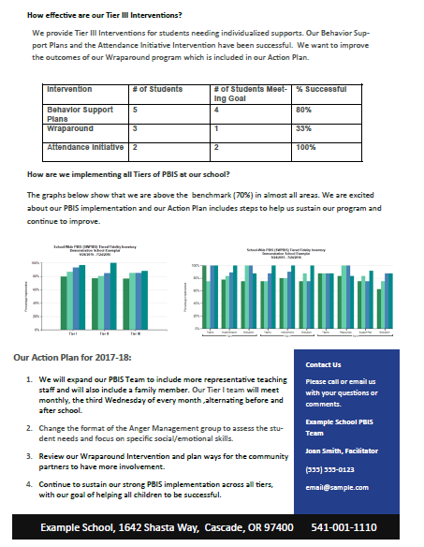
Evaluation Example
Back to ALL ITEMS
Notes:
Here is an example of an evaluation snapshot that can easily be shared with staff, families and district leadership.

Slide 61
Questions?
Contact:
support@pbisapps.org
training@pbisapps.org
855-455-8194
Notes:
Thank you for reviewing the Tiered Fidelity Inventory 3.0 resource presentation. The purpose of this slide deck is to review the format of the fidelity tool, provide clear steps for administration, and provide scoring guidance for school teams.
If you have further questions, please reach out to us at support@pbisapps.org, training@pbisapps.org, or give us a call at 855-455-8194

